Slide 2
Inclined Planes
An inclined plane is a surface set at an angle against a horizontal surface.
Some examples of an inclined plane are ramps and sloping roads

Slide 3
Weight of an object
The weight of an object is always vertical and goes straight down
This is drawn with a vector going straight down from the center of the object
The weight must be in newtons, and is found using the formula:
w=mg

Slide 4
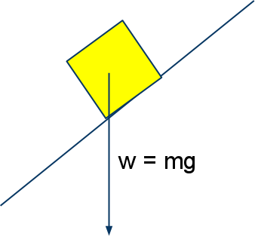
The image above shows the weight of the object, which is always vertical regardless of the surface the object is on.

Slide 5
The Normal Force
The normal force is not directly upward like on a horizontal surface
Instead, the normal force will be at an angle because it has to be perpendicular to the surface that the object is on
The normal force is equal to the perpendicular force

Slide 6
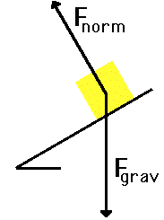
This image shows the normal force, which is perpendicular to the surface

Slide 7
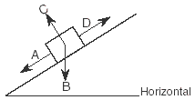
Practice Problems
In the diagram below, a box is at rest on an inclined plane.
Which vector best represents the direction of the normal force acting on the box?
(1) A (2) B (3) C (4) D

Slide 8
Solution and Explanation
Correct Answer: (3) C
Explanation: The normal force has to always be perpendicular to the surface the object is on. Therefore C is the only logical answer.

Slide 9
The Accelerating Force
On a horizontal plane, the accelerating force would be horizontal
However, on an inclined plane, the accelerating force is parallel to the surface that the object is on
The force points in the same direction as where the object is moving
The accelerating force is equal to the parallel force

Slide 10
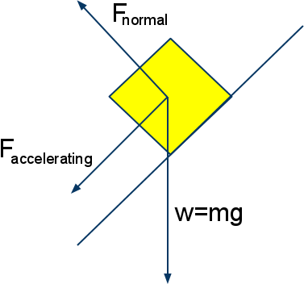
The accelerating force is parallel to the surface that the object is on

Slide 11
The Parallel and Perpendicular Force
The parallel force is the accelerating force
The formula used to calculate the parallel force is:
Fparallel= mg(sinθ)
The perpendicular force is the normal force
The formula used to calculate the perpendicular force is:
Fperpendicular = mg(cosθ)

Slide 12
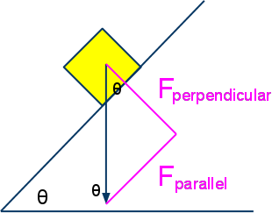
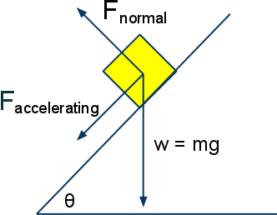
See the similarities?

Slide 13
Friction
Friction is the vector that is also parallel to the surface that the object is on; however, it goes in the opposite direction of the accelerating force
When the object is in rest, the friction is equal to the accelerating force
When the object is not in rest, friction can be calculated using:
F_{friction} = μF_{normal}
μ is the coefficient of friction, which changes depending on the material and condition of the object and incline
The coefficient of friction is always constant

Slide 14
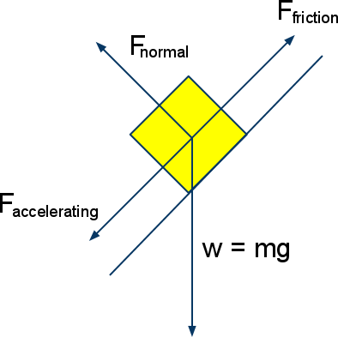
Friction is the force that goes in the opposite direction of the accelerating force

Slide 15
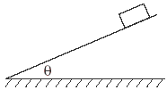
Problems
The diagram below shows a block sliding down a plane inclined at angle θ with the horizontal.
As angle θ is increased, the coefficient of kinetic friction between the bottom surface of the block and the surface of the incline will
(1) decrease (2) increase (3) remain the same

Slide 16
Solution and Explanation
Answer: (3) remain the same
Explanation: The coefficient of kinetic friction always remains constant as long as the material and condition of both the object and surface of the incline do not change.

Slide 17
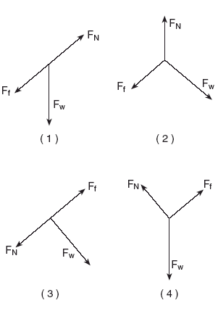
Problems
Amsco Page 33
142. The diagram below represents a block at rest on an incline.
Which diagram best represents the forces acting on the block? (F_{f} = frictional force, F_{N} = normal force, and F_{w} = weight.)

Slide 18
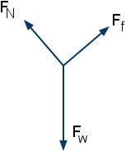
Solution and Explanation
Correct Answer: (4)
Explanation: The normal force has to be perpendicular to the object, the force of friction is parallel to the surface, and the force of the weight is always vertical. This was the only diagram that fulfilled all the requirements.

Slide 19
Homework
AMSCO:
pg. 47 #19
pg. 32 #128
pg. 48 #24

