Slide 1
Chapter 8 Rotational Motion

Slide 2
Contents of Chapter 8
Angular Quantities
Constant Angular Acceleration
Rolling Motion (Without Slipping)
Torque
Rotational Dynamics; Torque and Rotational Inertia
Solving Problems in Rotational Dynamics

Slide 3
Contents of Unit 8
Rotational Kinetic Energy
Angular Momentum and Its Conservation
Vector Nature of Angular Quantities
Torque and Rotational Motion

Slide 4
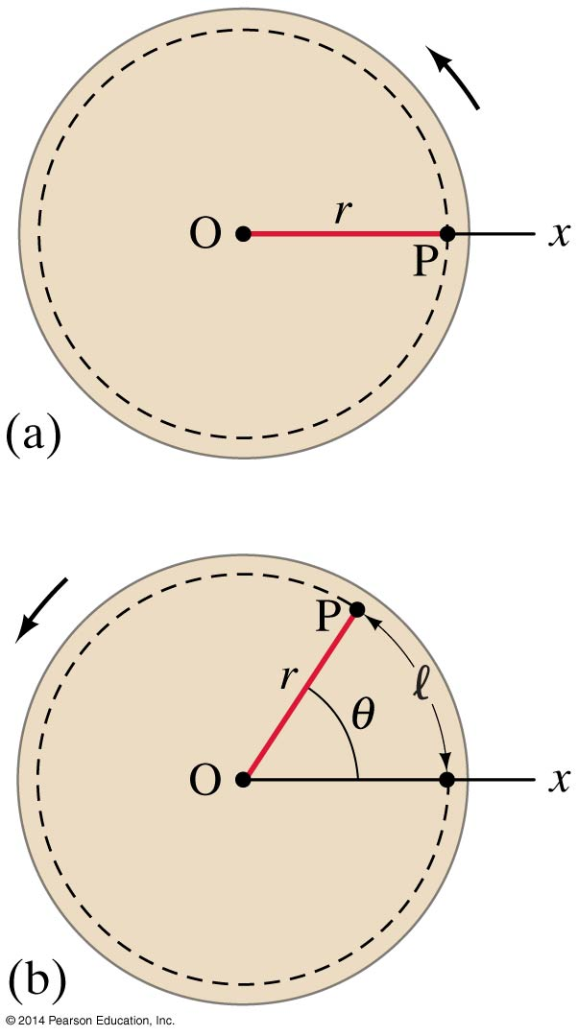
8-1 Angular Quantities
In purely rotational motion, all points on the object move in circles around the axis of rotation (“O”). The radius of the circle is r. All points on a straight line drawn through the axis move through the same angle in the same time. The angle θ in radians is defined:
where l is the arc length.
(8-1a)

Slide 5
8-1 Angular Quantities
In purely rotational motion, all points on the object move in circles around the axis of rotation (“O”). The radius of the circle is r. All points on a straight line drawn through the axis move through the same angle in the same time. The angle θ in radians is defined:
where l is the arc length.
(8-1a)
Rearrange to get $l=rθ$

Slide 6
Radians and Degrees
Radians can be related to degrees by saying,
$$360°=2 π rad$$
and
$$1 rad =\frac{360°}{2π}≈\text{57.3}°$$

Slide 7
Radians and Degrees
Example 1: A bike wheel rotates 4.50 revolutions. How many radians has it rotated?

Slide 8
Radians and Degrees
Example 1: A bike wheel rotates 4.50 revolutions. How many radians has it rotated?
Remember…$360°=2 π rad$ and
$1 rad =\frac{360°}{2π}≈\text{57.3}°$
and
1 rev = $360°=2 π rad$ = 6.28 rad
So,
$$4.50 revs =\left(4.50 revs\right)\left(2 π \frac{rad}{rev}\right)=9.00π rad=28.3 rad$$

Slide 9
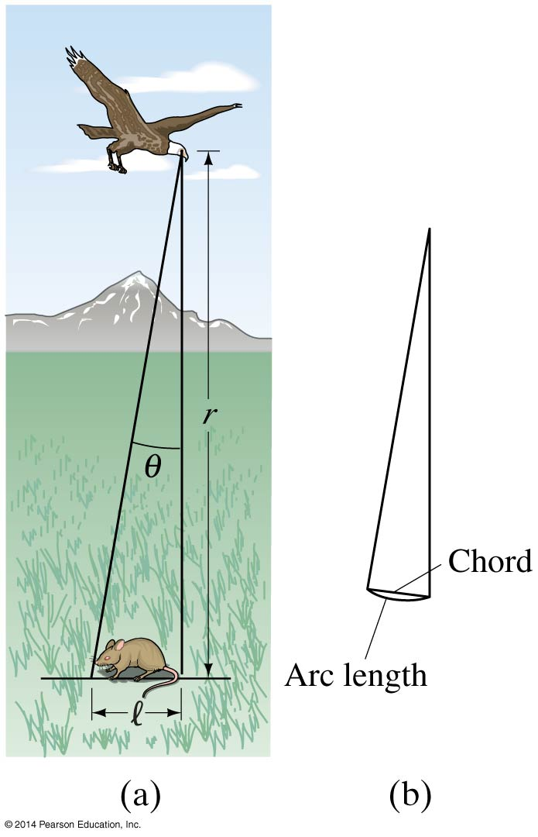
Radians and Degrees
Example 2: A particular bird’s eye can just distinguish objects that subtend an angle no smaller than about $3 x {10}^{−4}$ rad. How many degrees is this? How small an object can the bird just distinguish when flying at a height of 100 m?

Slide 10
Radians and Degrees
Example 2: A particular bird’s eye can just distinguish objects that subtend an angle no smaller than about $3 x {10}^{−4}$ rad (θ). How many degrees is this? How small an object can the bird just distinguish when flying at a height of 100 m (r)?
a. $\left(3 x {10}^{−4}\right)\left(\frac{360°}{2π rad}\right)=0.017°$
Note, for small angles, the arc length l and chord length are approximately the same, nearly a straight l
b. l = r θ = (100 m)($3 x {10}^{−4}$ rad) = $3 x {10}^{−2}$ m
or 3 cm.

Slide 11
Angular and Rotational Similarities
Side-By-Side Comparison between Linear and Angular

Slide 12
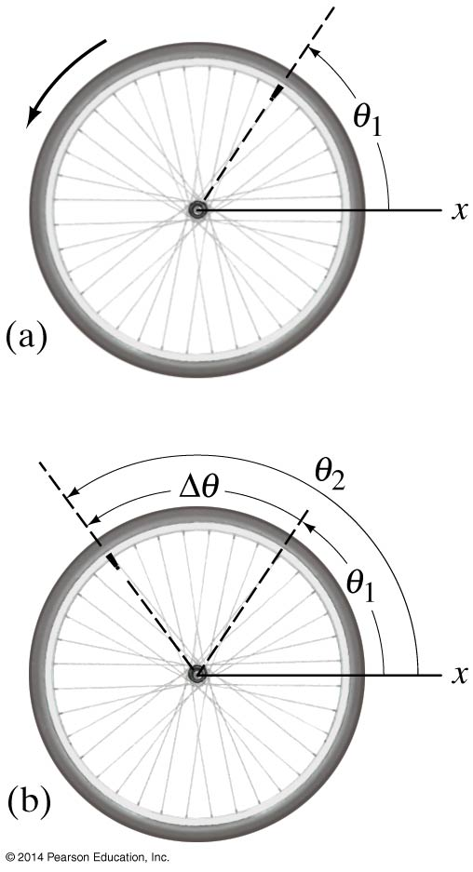
8-1 Angular Quantities
Angular displacement:
Δθ = θ₂ – θ₁
The average angular velocity is defined as the total angular displacement divided by time:
The instantaneous angular velocity:
(8-2a)
(8-2b)

Slide 13
8-1 Angular Quantities
Angular displacement:
Δθ = θ₂ – θ₁
The average angular velocity is defined as the total angular displacement divided by time:
The instantaneous angular velocity:
θ is unitless because it is represented by a length l and another length r so the units cancel
(8-2a)
(8-2b)

Slide 14
8-1 Angular Quantities
Angular displacement:
Δθ = θ₂ – θ₁
The average angular velocity is defined as the total angular displacement divided by time:
The instantaneous angular velocity:
Does this remind you of Δd = d₂ – d₁?
(8-2a)
Does this remind you of velocity?
(8-2b)

Slide 15
8-1 Angular Quantities
The angular acceleration is the rate at which the angular velocity changes with time:
The instantaneous acceleration:
(8-3a)
(8-3b)

Slide 16
8-1 Angular Quantities
The angular acceleration is the rate at which the angular velocity changes with time:
The instantaneous acceleration:
Does this remind you of Δv = v₂ – v₁?
(8-3a)
Does this remind you of acceleration?
(8-3b)

Slide 17
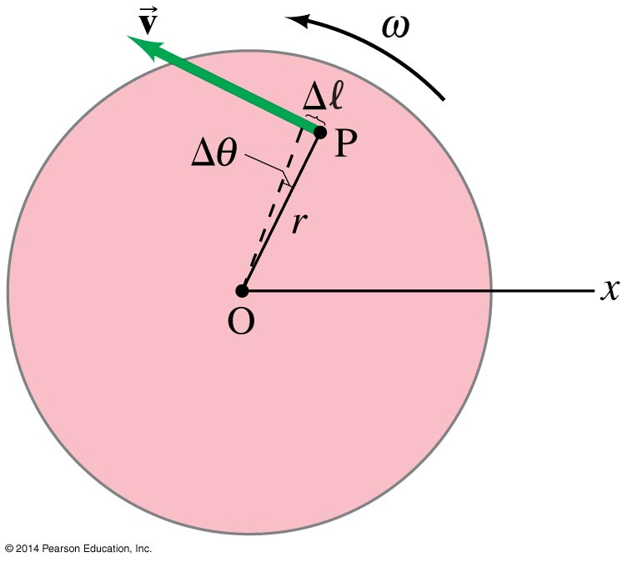
8-1 Angular Quantities
Every point on a rotating body has an angular velocity ω and a linear velocity v.
They are related:
(8-4)
Since ω is radians per second, r times ω yields m/s, linear velocity

Slide 18
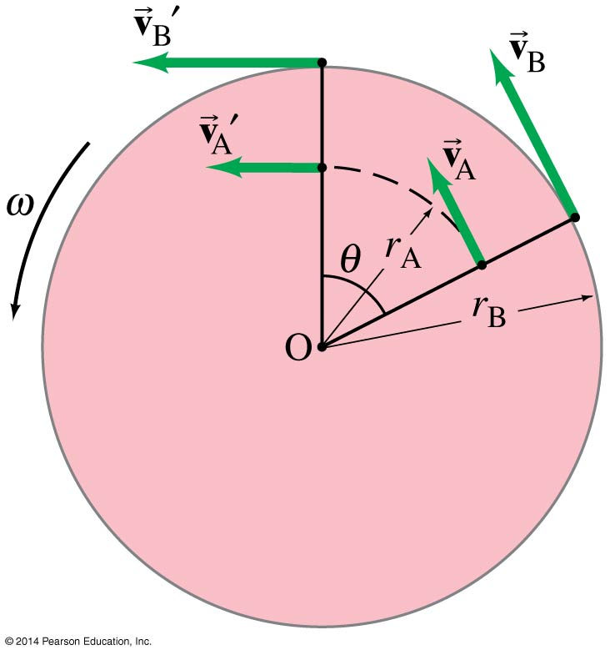
8-1 Angular Quantities
Therefore, objects farther from the axis of rotation will move faster.
Remember
$$v= \frac{2πr}{T}$$
which depends upon r. As r gets larger so does v

Slide 19
8-1 Angular Quantities
Therefore, objects farther from the axis of rotation will move faster.

Slide 20
8-1 Angular Quantities
Therefore, objects farther from the axis of rotation will move faster.

Slide 21
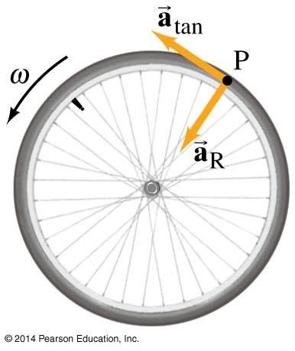
8-1 Angular Quantities
If the angular velocity of a rotating object changes, it has a tangential acceleration:
Even if the angular velocity is constant, each point on the object has a centripetal acceleration:
(8-5)
(8-6)

Slide 22
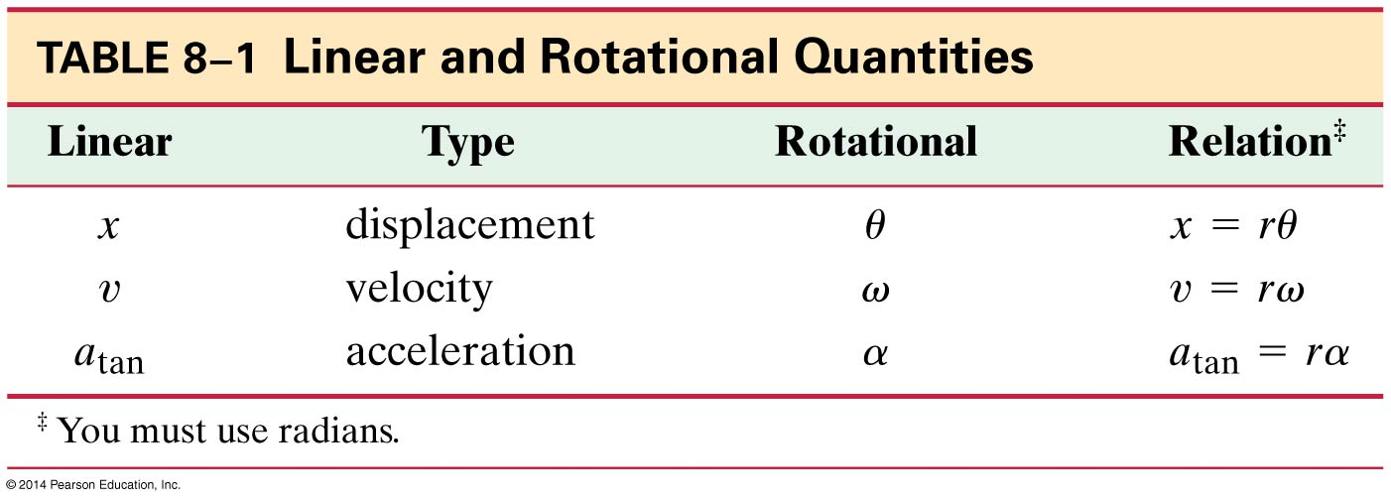
8-1 Angular Quantities
Here is the correspondence between linear and rotational quantities:

Slide 23
8-1 Angular Quantities
The frequency is the number of complete revolutions per second:
f = ω/2π
Frequencies are measured in hertz.
1 Hz = 1 s⁻¹
The period is the time one revolution takes:
ω is in radians per second so this also yields radians per second, whereas T equals seconds per radian
(8-8)

Slide 24
Is the Lion Faster than the Horse?
Example 3: Is the lion faster than the horse? On a rotating carousel or merry-go-round, one child sits on a horse near the outer edge and another child sits on a lion halfway out from the center. (a) Which child has the greater linear velocity? (b) Which child has the greater angular velocity?

Slide 25
Is the Lion Faster than the Horse?
Example 3: Is the lion faster than the horse? On a rotating carousel or merry-go-round, one child sits on a horse near the outer edge and another child sits on a lion halfway out from the center. (a) Which child has the greater linear velocity? (b) Which child has the greater angular velocity?
a. Remember, for circular motion $v=\frac{2πr}{T}$ and for a rotating object any point along the same radial line rotates around the center in the same period, T. So T₁ = T₂ . As stated, the radius for the horse, $r_{h}$, is twice the radius for the lion, $r_{l}$, or $r_{h}=2r_{l}$
$v_{h}=\frac{2πr_{h}}{T}=\frac{2π2r_{l}}{T}=\frac{4πr_{l}}{T}$
$v_{l}=\frac{2πr_{l}}{T}$
Divide $v_{h}$ by $v_{l}$ and rearrange to get the relationship,
$$v_{h}=2v_{l}$$

Slide 26
Is the Lion Faster than the Horse?
Example 3: Is the lion faster than the horse? On a rotating carousel or merry-go-round, one child sits on a horse near the outer edge and another child sits on a lion halfway out from the center. (a) Which child has the greater linear velocity? (b) Which child has the greater angular velocity?
b. Recall the new equation, $v=rω$
$ω=$ $\frac{v}{r}$
$ω_{1}=$ $\frac{v_{1}}{r_{1}}$ =$\frac{{2v}_{2}}{{2r}_{2}}$ =$\frac{v_{2}}{r_{2}}$
$ω_{2}=$ $\frac{v_{2}}{r_{2}}$
$ω_{1}=$ $ω_{2}$

Slide 27
Angular and Linear Velocities
Example 4: A carousel is initially at rest. At t = 0 it is given a constant angular acceleration α = .060 rad/_{s}² which increases it angular velocity for 8.0 s. At t = 8.0 s , determine (a) the angular velocity of the carousel, and (b) the linear velocity of a child located 2.5 m from the center of the carousel.

Slide 28
Angular and Linear Accelerations
Example 5: For the child on the rotating carousel of the previous example, determine that child’s (a) tangential (linear) acceleration, (b) centripetal acceleration, (c) total acceleration.

Slide 29
8-2 Constant Angular Acceleration
The equations of motion for constant angular acceleration are the same as those for linear motion, with the substitution of the angular quantities for the linear ones.

Slide 30
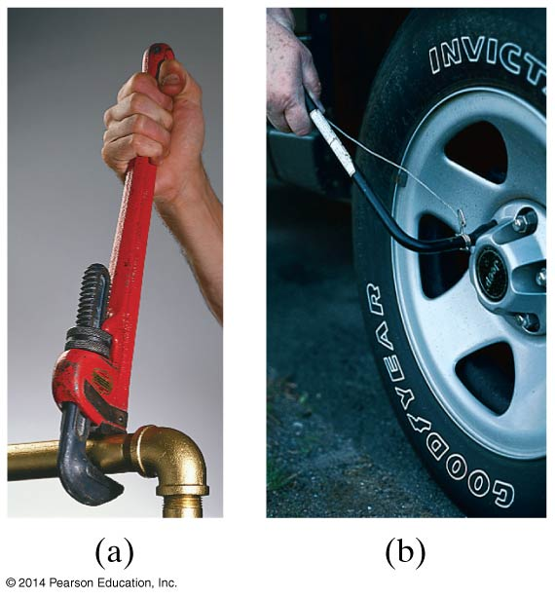
8-3 Torque
A longer lever arm is very helpful in rotating objects.

Slide 31
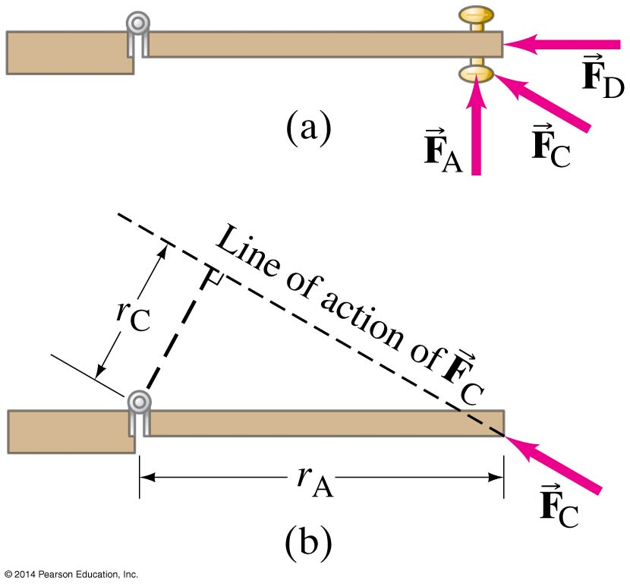
8-3 Torque
Here, the lever arm for F_{A} is the distance from the knob to the hinge; the lever arm for F_{D} is zero; and the lever arm for F_{C} is as shown. [It is easier for me to look at it as the F_{C} component that is perpendicular to the lever, in this case the door.]

Slide 32
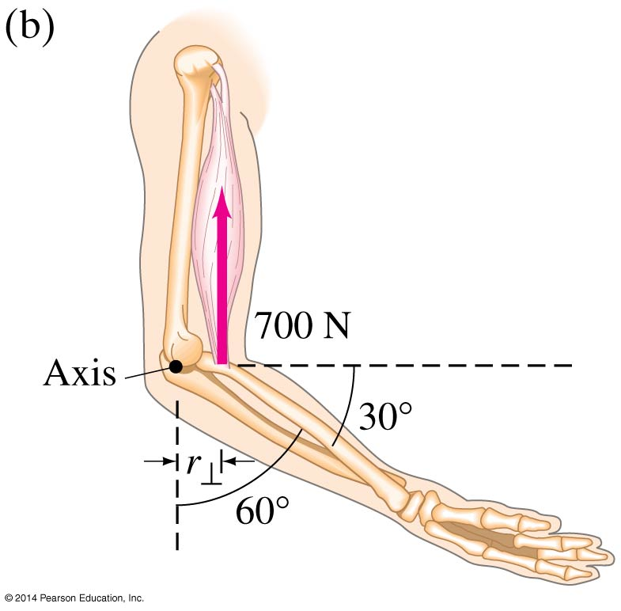
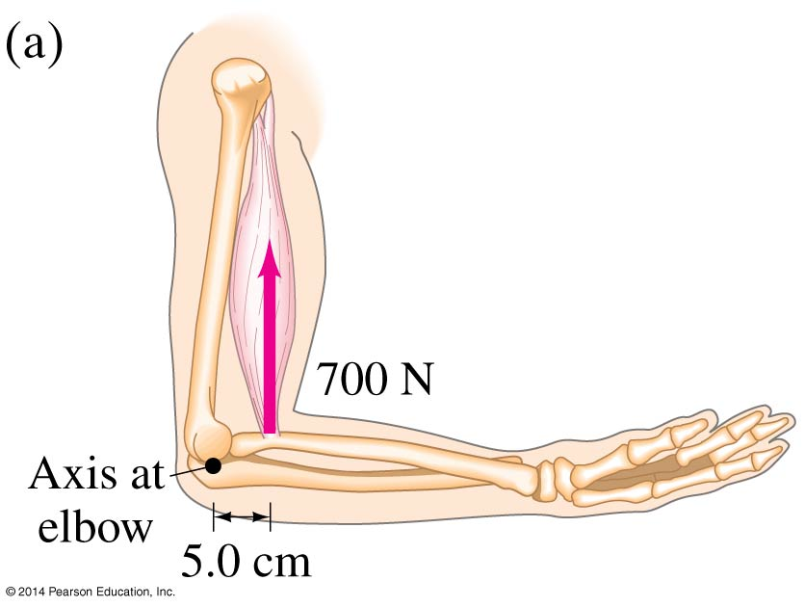
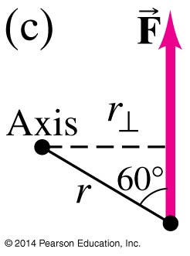
8-2 Torque
The torque is defined as:
(8-10a)

Slide 33
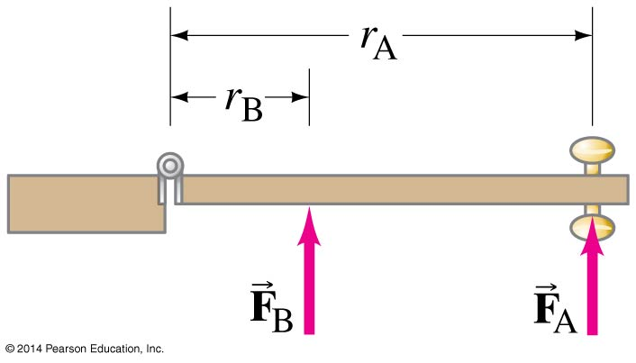
8-3 Torque
To make an object start rotating, a force is needed; the position and direction of the force matter as well.
The perpendicular distance from the axis of rotation to the line along which the force acts is called the lever arm.

Slide 34
Torque
Example 8: The biceps muscle exerts a vertical force on the lower arm, bent as shown. For each case, calculate the torque about the axis of rotation through the elbow joint, assuming the muscle is attached 5.0 cm from the elbow axis.

Slide 35
Torque
Example 8: The biceps muscle exerts a vertical force on the lower arm, bent as shown. For each case, calculate the torque about the axis of rotation through the elbow joint, assuming the muscle is attached 5.0 cm from the elbow axis.
We are only interested in the perpendicular force applied to the lever. Yes, you guessed it, more sine cosine!

Slide 36
Torque
Example 8: The biceps muscle exerts a vertical force on the lower arm, bent as shown. For each case, calculate the torque about the axis of rotation through the elbow joint, assuming the muscle is attached 5.0 cm from the elbow axis.
We are only interested in the perpendicular force applied to the lever. Yes, you guessed it, more sine cosine!

Slide 37
Torque
Why?
30

Slide 38
Torque
Why? Because forces parallel to the lever do not create torque.
30

Slide 39
Torque
Only the red vector rotates the forearm toward the biceps. Conversely, the triceps does the reverse and counters the biceps.
30

Slide 40
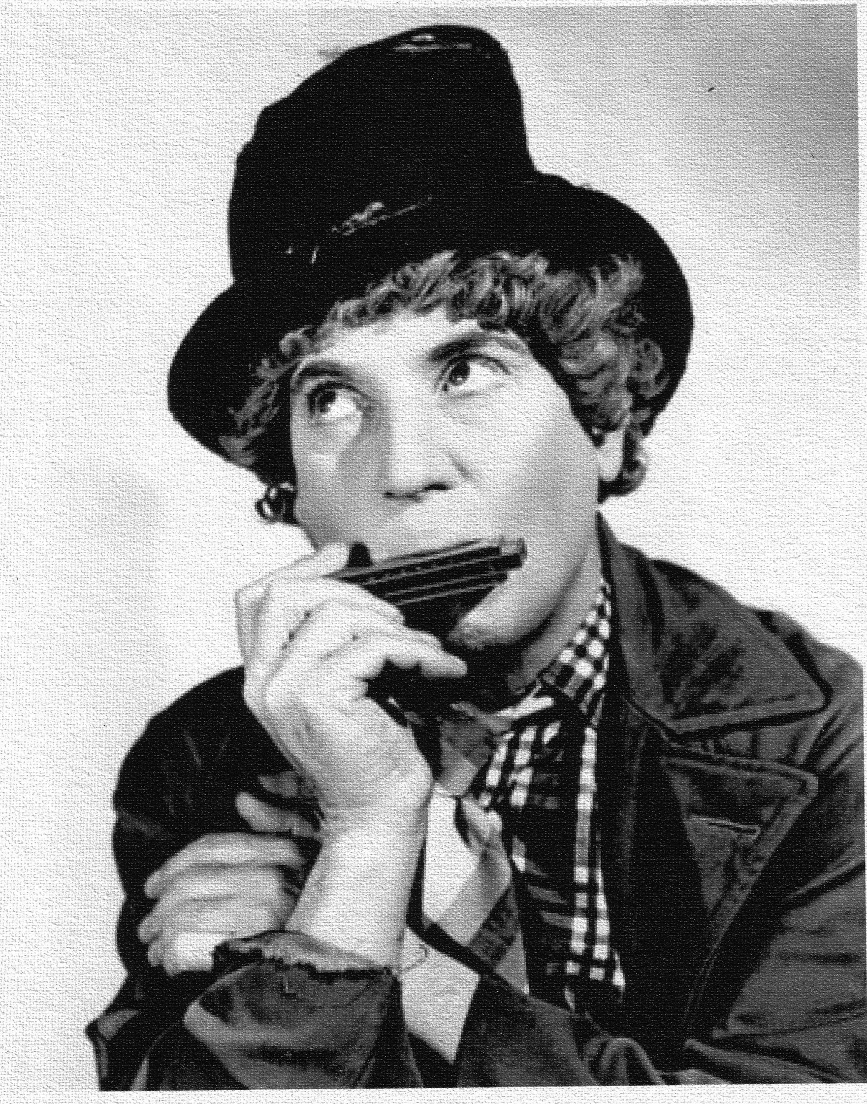
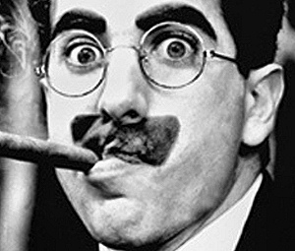
Problem 25: Calculate the net torque about the axle of the wheel shown in the figure. Assume that a friction torque of .60 Nm opposes the motion.
“This is enough to make your axle spin!”
“This is enough to make your axle spin!”
“You can say that again.”

Slide 41
Problem 25: Calculate the net torque about the axle of the wheel shown in the figure. Assume that a friction torque of .60 Nm opposes the motion.

Slide 42
Problem 25: Calculate the net torque about the axle of the wheel shown in the figure. Assume that a friction torque of .60 Nm opposes the motion.
$$∑τ=\left(.12m\right)\left(35N\right)+\left(.24m\right)\left(18N\right)−\left(.24\right)\left(28N\right)−.6Nm$$
$∑τ=4.2Nm+4.32Nm−6.72Nm−.6Nm$=1.2Nm clockwise

Slide 43
Problem 29: Determine the net torque on the 2.0 m long uniform beam shown in the figure. All forces are shown. Calculate the net torque about C and again about P. Note, here “about” means around. You’ve likely heard the term “coming about” for sailing, coming around is the layman’s term

Slide 44
Problem 29: Determine the net torque on the 2.0 m long uniform beam shown in the figure. All forces are shown. Calculate the net torque about C and again about P. Note, here “about” means around. You’ve likely heard the term “coming about” for sailing, coming around is the layman’s term
About C:
$$∑τ_{C}=\left(sin32\right)\left(56N\right)\left(1m\right)−\left(sin58\right)\left(52N\right)\left(1m\right)=29.68Nm−44.1Nm=−14.42Nm [ccw]$$
About P:
$$∑τ_{P}=\left(−sin45\right)\left(65N\right)\left(1m\right)+\left(sin32\right)\left(56N\right)\left(2m\right)=−45.96Nm+59.35Nm=13.39Nm [cw]$$

Slide 45
8-5 Rotational Dynamics; Torque and Rotational Inertia
Knowing that F = ma, we see that τ = mr²α
Say, What?
$$F=ma$$
and,
$$τ=Fr=\left(ma\right)r$$
linear a = r$α$, so substitute in for a and simplify
$$τ=Fr=\left(ma\right)r=\left(m\left(αr\right)\right)r=mαr^{2}=mr^{2}α$$

Slide 46
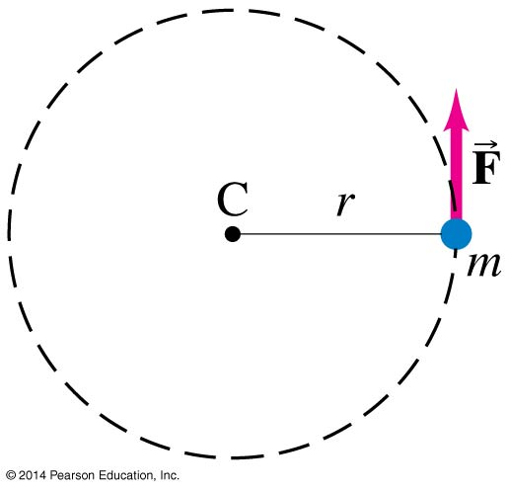
8-5 Rotational Dynamics; Torque and Rotational Inertia
As I was saying, knowing that F = ma, we see that τ = mr²α
This is for a single point mass; what about an extended object?
As the angular acceleration is the same for the whole object, we can write:
(8-12)
We separated the ∑τ=mr² from the alpha, because it has a special name and is called the property of…

Slide 47
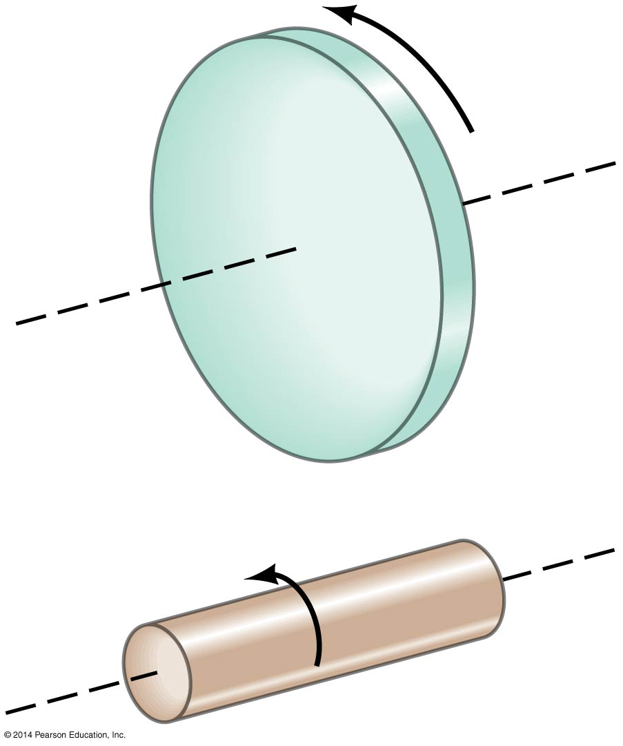
8-5 Rotational Dynamics; Torque and Rotational Inertia
The quantity I = Σmr² is called the rotational inertia of an object.
The distribution of mass matters here—these two objects have the same mass, but the one on the top has a greater rotational inertia, as so much of its mass is far from the axis of rotation.

Slide 48
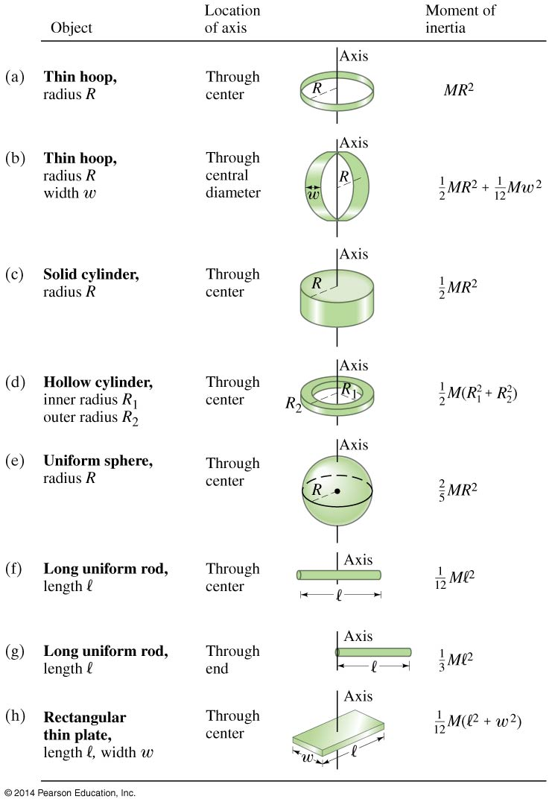
8-5 Rotational Dynamics; Torque and Rotational Inertia
The rotational inertia of an object depends not only on its mass distribution but also the location of the axis of rotation—compare (f) and (g), for example.

Slide 49
m = 10 kg
R1 = 2 m
R2 = 2.2 m
w = .03 m
Use these for f, g, h
l = 2 m
w = .5 m
????????
????????
????????
????????
????????
????????
????????
????????

Slide 50
m = 10 kg
R1 = 2 m
R2 = 2.2 m
w = .03 m
Use these for f, g, h
l = 2 m
w = .5 m
40 kg $m^{2}$
20 kg $m^{2}+ .00075=20.00075$
????????
????????
????????
????????
????????
????????

Slide 51
m = 10 kg
R1 = 2 m
R2 = 2.2 m
w = .03 m
Use these for f, g, h
l = 2 m
w = .5 m
40 kg $m^{2}$
20 kg $m^{2}+ .00075=20.00075$
20 kg $m^{2}$
44.2 kg $m^{2}$
????????
????????
????????
????????

Slide 52
m = 10 kg
R1 = 2 m
R2 = 2.2 m
w = .03 m
Use these for f, g, h
l = 2 m
w = .5 m
40 kg $m^{2}$
20 kg $m^{2}+ .00075=20.00075$
20 kg $m^{2}$
44.2 kg $m^{2}$
16 kg $m^{2}$
3.33 kg $m^{2}$
????????
????????

Slide 53
m = 10 kg
R1 = 2 m
R2 = 2.2 m
w = .03 m
Use these for f, g, h
l = 2 m
w = .5 m
40 kg $m^{2}$
20 kg $m^{2}+ .00075=20.00075$
20 kg $m^{2}$
44.2 kg $m^{2}$
16 kg $m^{2}$
3.33 kg $m^{2}$
13.33 kg $m^{2}$
3.54 kg $m^{2}$

Slide 54
Problem 8-9: Two weights on a bar with different axes produce different I. Two small weights of mass 5.0 kg and 7.0 kg are mounted 4.0m apart on a light rod (ignore its mass) as shown in the figure. Calculate the moment of inertia of the system (a) when rotated about an axis halfway between the weights and (b) when rotated about an axis 0.5. m to the left of the 5.0 kg mass, as shown.

Slide 55
Problem 8-9: Two weights on a bar with different axes produce different I. Two small weights of mass 5.0 kg and 7.0 kg are mounted 4.0m apart on a light rod (ignore its mass) as shown in the figure. Calculate the moment of inertia of the system (a) when rotated about an axis halfway between the weights and (b) when rotated about an axis 0.5. m to the left of the 5.0 kg mass, as shown.
$$I= ∑mr^{2}=\left(5.0 kg\right) {\left(2.0 m\right)}^{2}+\left(7.0 kg\right){\left(2.0 m\right)}^{2}=$$
$$20 kgm^{2} +28 kgm^{2}=48 kgm^{2}$$

Slide 56
Problem 8-9: Two weights on a bar with different axes produce different I. Two small weights of mass 5.0 kg and 7.0 kg are mounted 4.0m apart on a light rod (ignore its mass) as shown in the figure. Calculate the moment of inertia of the system (a) when rotated about an axis halfway between the weights and (b) when rotated about an axis 0.5. m to the left of the 5.0 kg mass, as shown.
$$I= ∑mr^{2}=\left(5.0 kg\right) {\left(2.0 m\right)}^{2}+\left(7.0 kg\right){\left(2.0 m\right)}^{2}=$$
$$20 kgm^{2} +28 kgm^{2}=48 kgm^{2}$$
$$I= ∑mr^{2}=\left(5.0 kg\right) {\left(0.5 m\right)}^{2}+\left(7.0 kg\right){\left(4.5 m\right)}^{2}=$$
$$1.3 kgm^{2} +142 kgm^{2}=143.3 kgm^{2}$$

Slide 57
Demo
Time with two setups…
Time 1—balanced bar
Time 2—unbalanced bar

Slide 58
8-7 Rotational Kinetic Energy [Remember the Ball in Cup Experiment?!]
The kinetic energy of a rotating object is given by
KE = Σ(½ mv²)
By substituting the rotational quantities, we find that the rotational kinetic energy can be written:
A object that has both translational and rotational motion also has both translational and rotational kinetic energy:
(8-15)
(8-16)

Slide 59
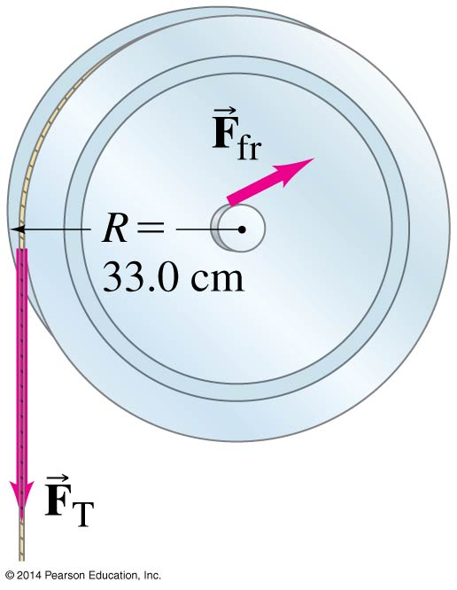
8-6 Solving Problems in Rotational Dynamics
Why not mg and F_{N}?
NOTE: This is Example 8-10 from
Giancoli
Draw a diagram.
Decide what the system comprises.
Draw a free-body diagram for each object under consideration, including all the forces acting on it and where they act.

Slide 60
8-6 Solving Problems in Rotational Dynamics
+
$∑τ=τ_{f}− {rF}_{T}=−1.1 Nm$+$\left(0.330 m\right)\left(15.0 N\right)=3.85 Nm$
Find the axis of rotation, determine the positive direction for rotation and annotate it; calculate the torques around the axis of rotation.

Slide 61
8-6 Solving Problems in Rotational Dynamics
Apply Newton’s second law for rotation. If the rotational inertia is not provided, you need to find it before proceeding with this step.
Net Torque:
$$∑τ=rF_{T}−τ_{f}=\left(0.33 m\right)\left(15.0 N\right)−1.1Nm=3.85Nm$$
Angular Acceleration:
$$α=\frac{∆ω}{∆t}=\frac{30.0\frac{rad}{s}−0}{3.00 s}=10.0 \frac{rad}{s^{2}}$$
Newton’s Second Law for Rotation:
$$∑τ=Iα or I=\frac{∑τ}{α}$$

Slide 62
8-6 Solving Problems in Rotational Dynamics
Apply Newton’s second law for translation and other laws and principles as needed.
Solve.
$$I=\frac{∑τ}{α}=\frac{3.85 Nm}{10.0 \frac{rad}{s^{2}}}=3.85 kgm^{2}$$
Check your answer for units and correct order of magnitude.
$$I≈\frac{1}{2}MR^{2}=\frac{1}{2}(4.00kg)(0.33. m)^{2}=0.218 kgm^{2}$$
NOTE: Same order of magnitude but also pulley is not quite a disk.

Slide 63
A Clarification…
In general the greater the distance the mass is concentrated from the center of rotation the greater the Inertia. But, when talking about which
$$MgH=\frac{1}{2}Mv^{2}+\frac{1}{2}Iω^{2}$$
Substituting for I where
$$I=\frac{x}{y}MR^{2}$$
We get
$$MgH=\frac{1}{2}Mv^{2}+\frac{1}{2}(\frac{x}{y}MR^{2})ω^{2}$$

Slide 64
A Clarification…
$$gH=\frac{1}{2}v^{2}+\frac{1}{2}(\frac{x}{y}R^{2})ω^{2}$$
$$gH=\frac{1}{2}v^{2}+\frac{1}{2}(\frac{x}{y}R^{2}){\frac{v^{2}}{R^{2}}}^{}$$
$$gH=\frac{1}{2}v^{2}+\frac{1}{2}(\frac{x}{y}v^{2})$$
$gH=\frac{1}{2}v^{2}(1+(\frac{x}{y})$)
All terms have M so they cancel. $ω$ is in terms of $\frac{v^{2}}{R^{2}}$ so the R²’s cancel. This means translational speed DOES NOT DEPEND ON M OR R. It depends only on the $\frac{x}{y}$ in front of I (which is directly related to its shape) and the height of the incline H.

Slide 65
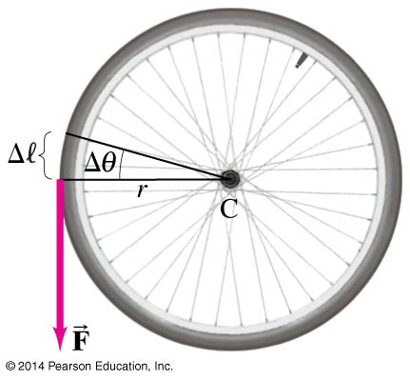
8-7 Rotational Kinetic Energy
The torque does work as it moves the wheel through an angle θ:
(8-17)

Slide 66
8-8 Angular Momentum and Its Conservation
In analogy with linear momentum, we can define angular momentum L:
We can then write the total torque as being the rate of change of angular momentum.
If the net torque on an object is zero, the total angular momentum is constant.
Iω = I₀ω₀ = constant
(8-18)
[p = mv]

Slide 67
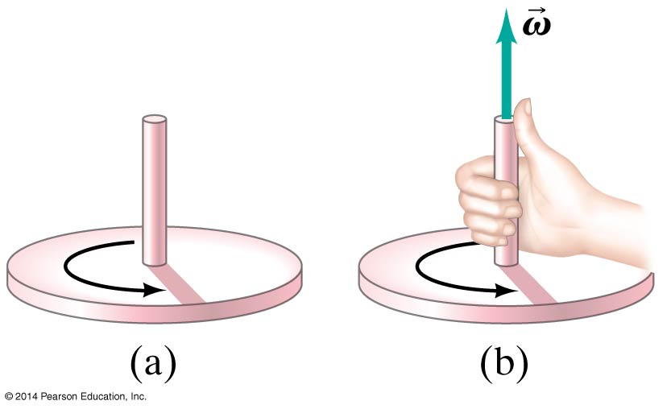
8-9 Vector Nature of Angular Quantities
The angular velocity vector points along the axis of rotation; its direction is found using a right hand rule:

Slide 68
8-9 Vector Nature…DJ’s question of “Why?”

Slide 69
8-9 Vector Nature…DJ’s question of “Why?”

Slide 70
And this makes sense because the torque accelerates or decelerates the spin—imagine you turn the rod, fingers forward to accelerate and spin it fingers backwards to slow it down…

Slide 71
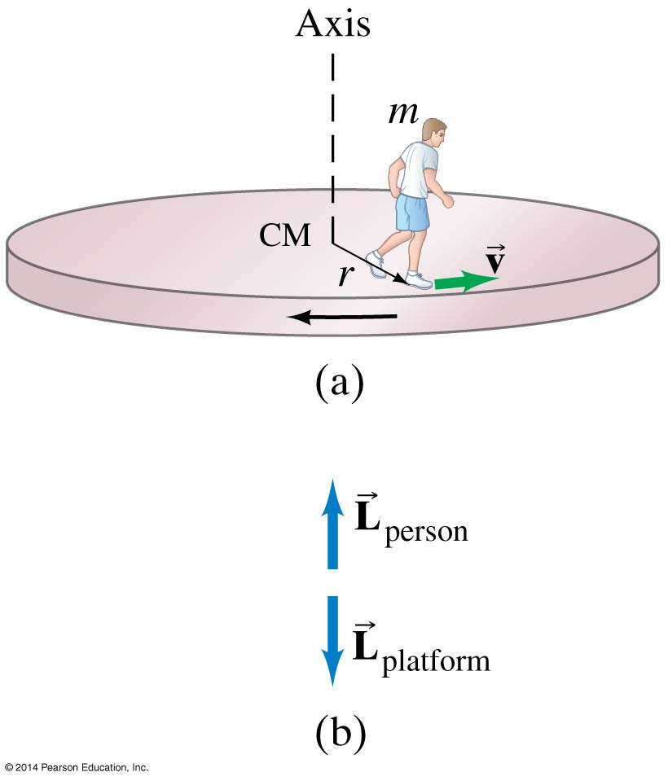
8-9 Vector Nature of Angular Quantities
Angular acceleration and angular momentum vectors also point along the axis of rotation.

Slide 72
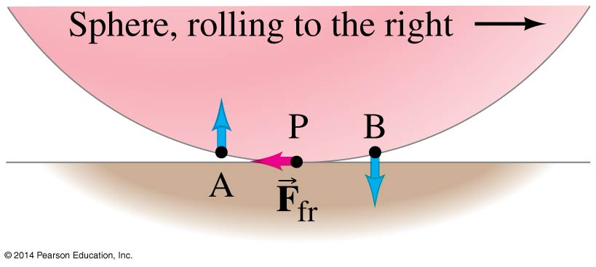
8-7 Rotational Kinetic Energy
When using conservation of energy, both rotational and translational kinetic energy must be taken into account.
All these objects have the same potential energy at the top, but the time it takes them to get down the incline depends on how much rotational inertia they have.

Slide 73
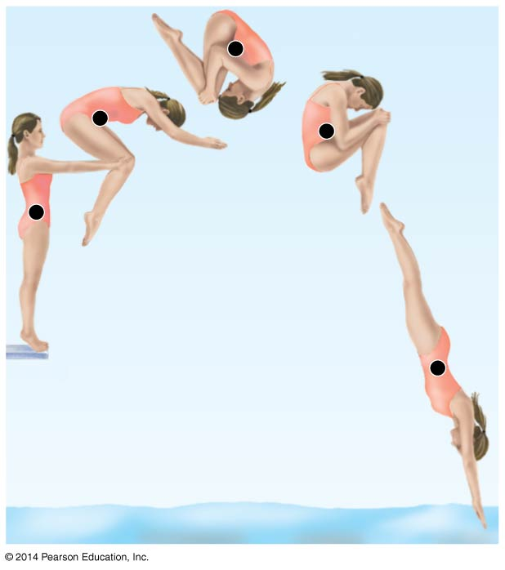
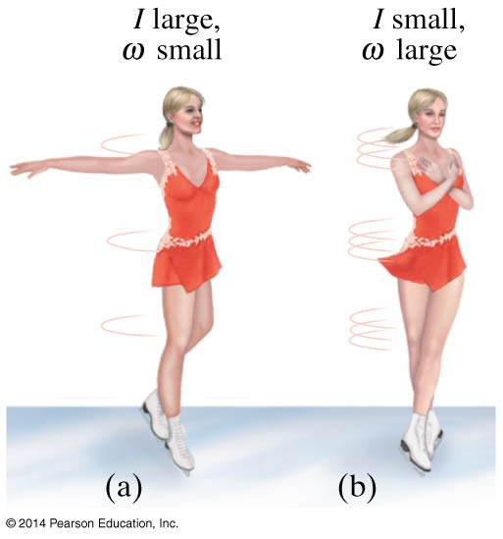
8-8 Angular Momentum and Its Conservation
Therefore, systems that can change their rotational inertia through internal forces will also change their rate of rotation:

Slide 74
Summary of Chapter 8
Angles are measured in radians; a whole circle is 2π radians.
Angular velocity is the rate of change of angular position.
Angular acceleration is the rate of change of angular velocity.
The angular velocity and acceleration can be related to the linear velocity and acceleration.

Slide 75
Summary of Chapter 8
The frequency is the number of full revolutions per second; the period is the inverse of the frequency.
The equations for rotational motion with constant angular acceleration have the same form as those for linear motion with constant acceleration.
Torque is the product of force and lever arm.
The rotational inertia depends not only on the mass of an object but also on the way its mass is distributed around the axis of rotation.

Slide 76
Summary of Chapter 8
The angular acceleration is proportional to the torque and inversely proportional to the rotational inertia.
An object that is rotating has rotational kinetic energy. If it is translating as well, the translational kinetic energy must be added to the rotational to find the total kinetic energy.
Angular momentum is L = Iω
If the net torque on an object is zero, its angular momentum does not change.

