Slide 1
Airspace Classification

Slide 2
Airspace Classifications
The federal airspace system is classified into six class designations. The objectives of this airspace classification are to
Simplify the airspace designations
Increase standardization of equipment and pilot requirements for operations in various classes of airspace
Promote pilot understanding of ATC services available
Achieve international commonality and satisfy our responsibilities as a member state of ICAO (International Civil Aviation Organization)

Slide 3
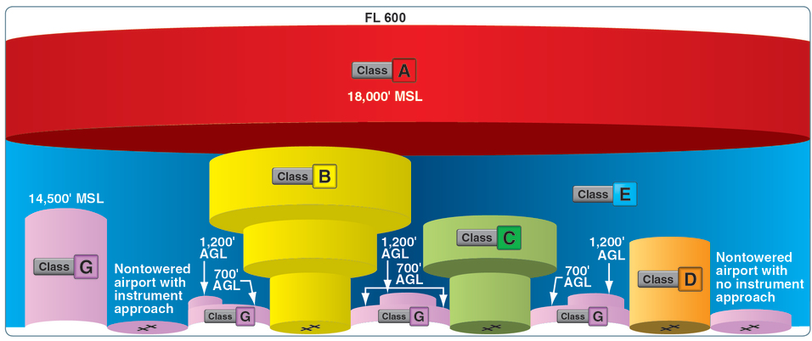

Slide 4
Class A Airspace
Located all over the world at 18,000 ft MSL and up

Slide 5
Class B Airspace
“Busy” - Think of Class B as the busy airspace. This surrounds large airports
Generally the airspace from the surface to 10,000 ft. MSL surrounding the nation’s busiest airports (e.g., Atlanta, Chicago, etc.).
The configuration of each Class B airspace area is individually tailored and consists of a surface area and two or more layers.
The lateral limits of Class B airspace are depicted by heavy blue lines on a sectional or terminal area chart.
The vertical limits of each section of Class B airspace are shown in hundreds of feet MSL.

Slide 6
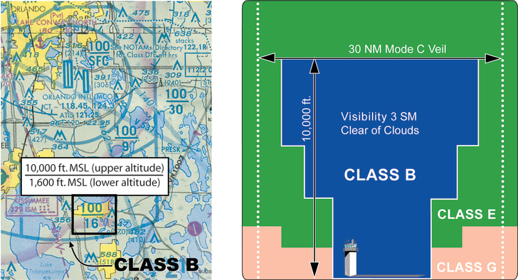
Notes:
Class B airspace is shown on the sectional chart (below left) and on the diagram (below right).

Slide 7
Class C Airspace
Surrounds those airports that have an operational control tower, are serviced by a radar approach control, and have a certain number of IFR operations or passenger enplanements.
The lateral limits of Class C airspace are depicted by solid magenta lines on sectional and some terminal area charts.
The vertical limits of each circle are shown in hundreds of feet MSL.
The inner surface area extends from the surface upward to the indicated altitude (usually 4,000 ft. above the airport elevation). It extends outward 5 NM from the primary airport.
The shelf area extends from the indicated altitude (usually 1,200 ft. above the airport elevation) to the same upper altitude limit as the surface area.

Slide 8
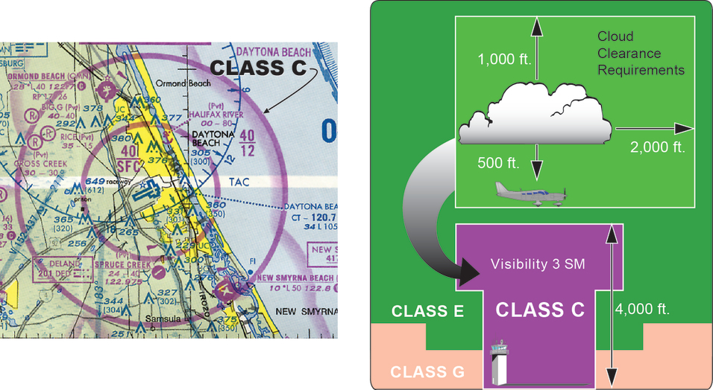
Notes:
Class C airspace vertical limits in the example extend
From the surface (SFC) to 4,000 ft. MSL (40) in the surface area
From 1,200 ft. MSL (12) to 4,000 ft. MSL in the shelf area

Slide 9
Class D Airspace
Surrounds those airports that have both an operating control tower and weather services available and that are not associated with Class B or C airspace.
Airspace at an airport with a part-time control tower is classified as Class D airspace only when the control tower is operating.
When a tower ceases operation, the Class D airspace reverts to Class E or a combination of Class G and Class E airspace.
Class D airspace is depicted by a blue segmented (dashed) circle on a sectional chart.
Class D airspace normally extends from the surface up to and including 2,500 ft. AGL.
The lateral limits of Class D airspace are depicted by dashed blue lines on a sectional or terminal area chart.
The ceiling (usually 2,500 ft. above the airport elevation) is shown within the circle in hundreds of feet MSL.
The radius of airspace area is usually 5 NM.
The lateral dimensions of Class D airspace are based on the instrument procedures for which the controlled airspace is established.

Slide 10
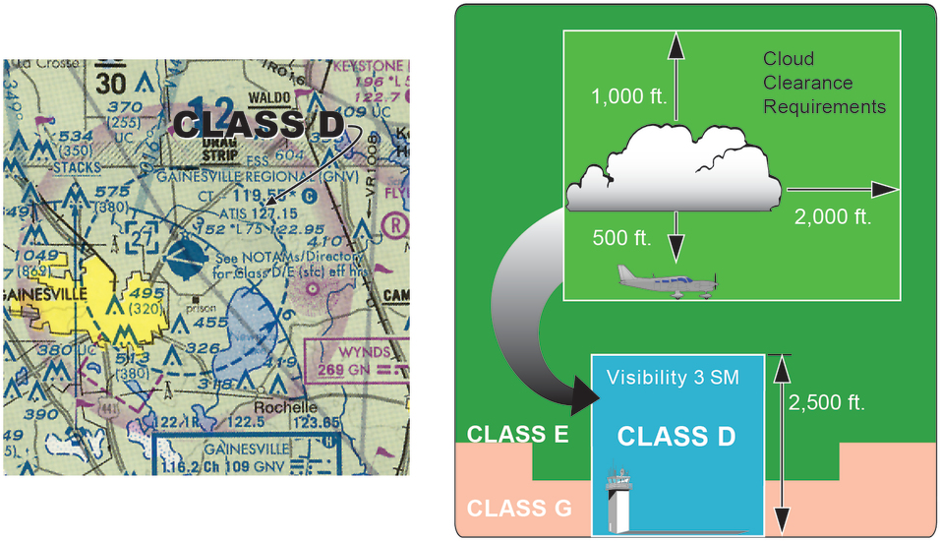
Notes:
The ceiling of Class D airspace in the examples is 2,700 ft. MSL.
If depicted, a dashed magenta line (see bottom left of sectional chart below) illustrates an area of Class E airspace extending upward from the surface.

Slide 11
Class E Airspace
“Everywhere else”
Any controlled airspace that is not Class A, B, C, or D airspace.
Except for 18,000 ft. MSL (the floor of Class A airspace), Class E airspace has no defined vertical limit but extends upward from either the surface or a designated altitude to the overlying or adjacent controlled airspace.
A dashed magenta line around an airport indicates Class E airspace extending upward from the surface.
A light magenta-shaded line indicates Class E airspace extending upward from 700 ft. AGL within the area enclosed by the line. Outside the line, Class E airspace begins at 1,200 ft. AGL.

Slide 12
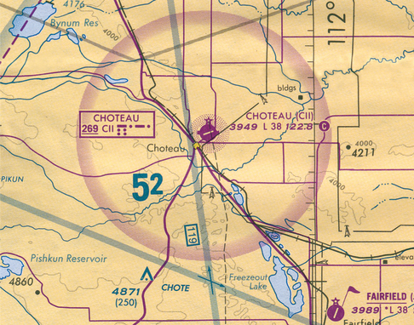
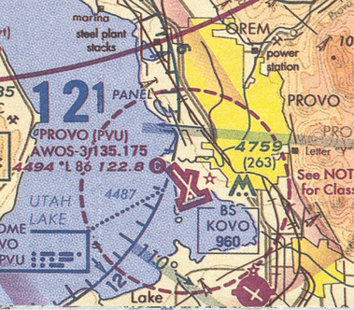
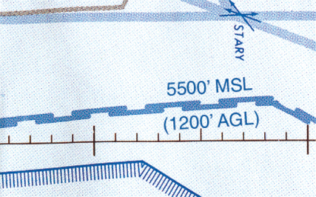
Notes:
The symbol shown below indicates Class E airspace extending upward from the indicated altitude. On sectional charts, it is illustrated in blue.

Slide 13
Class G Airspace
Airspace that has not been designated as Class A, Class B, Class C, Class D, or Class E airspace (i.e., it is uncontrolled airspace).
Class G airspace exists beneath the floor of controlled airspace in areas where the controlled airspace does not extend down to the surface.
Class G airspace vertical limit is up to, but not including, 14,500 ft. MSL.
Class G airspace is not shown. It is implied to exist everywhere controlled airspace does not exist.
Class G airspace extends upward from the surface to the floor of overlying controlled airspace.

Slide 14
Checkpoint
When a control tower located on an airport within Class D airspace ceases operation for the day, what happens to the airspace designation?
A. The airspace designation normally will not change.
B. The airspace remains Class D airspace as long as a weather observer or automated weather system is available.
C. The airspace reverts to Class E or a combination of Class E and G airspace during the hours the tower is not in operation.
Notes:
🍐 This is a Pear Deck Drawing Slide
🍐 To edit the type of question, go back to the "Ask Students a Question" in the Pear Deck sidebar.
C

Slide 15
Checkpoint
Which is true concerning the blue and magenta colors used to depict airports on Sectional Aeronautical Charts?
A. Airports with control towers underlying Class B, C, D, and E airspace are shown in blue.
B. Airports with control towers underlying Class C, D, and E airspace are shown in magenta.
C. Airports with control towers underlying Class A, B, and C airspace are shown in blue; Class D and E airspace are magenta.
Notes:
🍐 This is a Pear Deck Drawing Slide
🍐 To edit the type of question, go back to the "Ask Students a Question" in the Pear Deck sidebar.
A

Slide 16
Checkpoint
A blue segmented circle on a Sectional Chart depicts which class airspace?
A. Class B.
B. Class D.
C. Class C.
Notes:
🍐 This is a Pear Deck Drawing Slide
🍐 To edit the type of question, go back to the "Ask Students a Question" in the Pear Deck sidebar.
B

Slide 17
Checkpoint
Airspace at an airport with a part-time control tower is classified as Class D airspace only
A. when the associated control tower is in operation.
B. when the associated Flight Service Station is in operation.
C. when the weather minimums are below basic VFR.
Notes:
🍐 This is a Pear Deck Drawing Slide
🍐 To edit the type of question, go back to the "Ask Students a Question" in the Pear Deck sidebar.
A

Slide 18
Checkpoint
The lateral dimensions of Class D airspace are based on
A. the number of airports that lie within the Class D airspace.
B. the instrument procedures for which the controlled airspace is established.
C. 5 statute miles from the geographical center of the primary airport.
Notes:
🍐 This is a Pear Deck Drawing Slide
🍐 To edit the type of question, go back to the "Ask Students a Question" in the Pear Deck sidebar.
B

Slide 19
Prohibited Areas
airspace within which flight is prohibited. Such areas are established for security or other reasons of national welfare.
Prohibited areas protect government interests as well as ecologically sensitive areas.
Prohibited areas are often surrounded by large Temporary Flight Restrictions (TFRs) when certain situations exist.
Because prohibited areas protect areas the President often visits, pilots must be aware that large TFRs will be implemented around those areas when the President is present.
Prohibited areas have varied ceilings but all begin at the surface. Depending on the area protected, prohibited area ceilings range from 1,000 feet MSL to 18,000 feet MSL.
Notices of new, uncharted prohibited areas are disseminated via the Notice to Airmen (NOTAM) system.

Slide 20
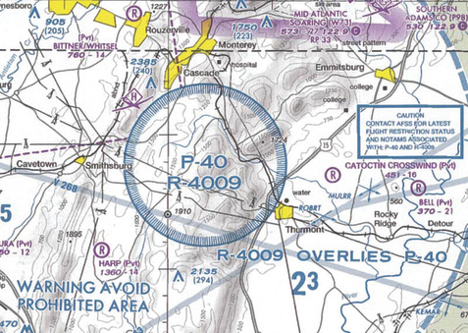
An example of a prohibited area, P-40 around Camp.

Slide 21
Restricted Areas
Airspace within which flight, while not wholly prohibited, is subject to restrictions. Restricted areas denote the existence of unusual, often invisible hazards to aircraft, such as artillery firing, aerial gunnery, or guided missiles.
Restricted areas are charted with an “R” followed by a number (e.g., R-4401).
The size and shape of restricted airspace areas vary based on the operation areas they restrict.
Restricted areas are often placed next to, or stacked on top of, each other.
The altitudes of restricted areas vary based on the operations conducted within them.
If a restricted area is active, a pilot must receive prior permission of the controlling agency before attempting to fly through it.
Times and altitudes of operation as well as the name of the controlling agency can be found on the sectional aeronautical chart.

Slide 22
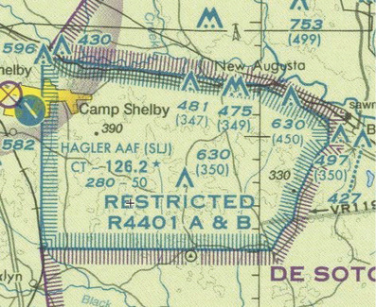
Restricted areas on a sectional chart.

Slide 23
Warning Areas
Airspace of defined dimensions, extending from 3 NM outward from the coast of the U.S., that contain activity that may be hazardous to nonparticipating aircraft. The purpose of a warning area is to warn nonparticipating pilots of the potential danger (such as the hazards in restricted areas).
A warning area may be located over domestic or international waters or both.
Warning areas should be thought of exactly as restricted areas are.
Because they are outside the 3 NM airspace boundary of U.S. airspace, they cannot be regulated as restricted areas are.
Times and altitudes of operation can be found on the sectional aeronautical chart.

Slide 24
Military operations areas (MOA)
Airspace established to separate certain military training activities from IFR traffic.
Pilots should exercise extreme caution while flying within an MOA when military activity is being conducted.
Before beginning a flight that crosses an MOA, contact any FSS within 100 NM of the area to obtain accurate real-time information concerning the MOA hours of operation.
Prior to entering an active MOA, contact the controlling agency for traffic advisories.
MOAs are often placed next to, or stacked on top of, each other.
The altitudes of MOAs vary based on the operations conducted within them.
Times and altitudes of operation as well as the name of the controlling agency can be found on the sectional aeronautical chart.
MOAs are often found in conjunction with restricted areas.
Pay careful attention to such airspace when planning crossing flights to ensure you do not violate active restricted airspace.

Slide 25
MOAs
Alert areas are depicted on aeronautical charts to inform nonparticipating pilots of areas that may contain a high volume of pilot training or an unusual type of aerial activity.
All activity within an alert area is conducted in accordance with Federal Aviation Regulations.
There is no specific controlling agency for an alert area, and crossing clearance is not required or given.
Controlled firing areas contain activities that, if not conducted in a controlled environment, could be hazardous to nonparticipating aircraft.
The activities are suspended immediately when spotter aircraft, radar, or ground lookout positions indicate an aircraft might be approaching the area.
These areas are not depicted on charts because the pilot is not required to take action.

Slide 26
Airport Advisories and MTRs
Airport advisory areas encompass the areas within 10 SM of airports that have no operating control towers but where FSSs are located. At such locations, the FSS provides advisory service to arriving and departing aircraft. Participation in the Local Airport Advisory (LAA) program is recommended but not required.
Military training routes (MTRs) are developed for use by the military for the purpose of conducting low-altitude (below 10,000 ft. MSL), high-speed training (more than 250 kt.).
The routes above 1,500 ft. AGL are flown, to the maximum extent possible, under IFR.
The routes at 1,500 ft. AGL and below are flown under VFR.
Extreme vigilance should be exercised when flying through or near these routes.
MTRs will be identified and charted as follows:
MTRs with no segment above 1,500 ft. AGL must be identified by four-number characters, e.g., IR1206, VR1207.
MTRs that include one or more segments above 1,500 ft. AGL must be identified by three-number characters, e.g., IR206, VR207.
Alternate IR/VR routes or route segments are identified by using the basic/principal route designation followed by a letter suffix, e.g., IR008A, VR1007B, etc.

Slide 27
Temporary flight restrictions
Temporary flight restrictions (TFRs) contain airspace where the flight of aircraft is prohibited without advanced permission and/or an FAA waiver. This restriction exists because the area inside the TFR is often of key importance to national security or national welfare. TFRs may also be put into effect in the vicinity of any incident or event that by its nature may generate such a high degree of public interest that hazardous congestion of air traffic is likely.
TFRs are very different from other forms of airspace because they are often created, canceled, moved, and/or changed.
The temporary nature of TFRs can make keeping track of their locations and durations challenging.
TFRs protect government interests as well as the general public.
TFRs often surround other forms of airspace when extra security is necessary.
Because TFRs protect the President, pilots must be aware that large TFRs will be implemented around any area where the President is present.
A NOTAM implementing temporary flight restrictions will contain a description of the area in which the restrictions apply.
The size and shape of TFRs vary based on the areas they protect.
Most TFRs are in the shape of a circle and are designed to protect the center of that circle.
TFRs always have defined vertical and lateral boundaries as indicated in the NOTAMs.

Slide 28
TFRs
Flight limitations in the proximity of space flight operations are designated in a NOTAM.
Flight restrictions in the proximity of Presidential and other parties are put into effect by a regulatory NOTAM to establish flight restrictions.
Restrictions are required because numerous aircraft and large assemblies of persons may be attracted to areas to be visited or traveled by the President or Vice President, heads of foreign states, and other public figures.
In addition, restrictions are imposed in the interest of providing protection to these public figures.
Presidential TFRs are issued with as much advanced notice as possible, given security concerns.
The President is always surrounded by a 10-NM no-fly zone from the surface to 18,000 ft. MSL.
No aircraft may operate in this area without a waiver or the advanced permission of the FAA.
The President is also surrounded by a 30-NM TFR.
Certain limited operations are allowed in this area.

Slide 29
TFRs
Tabulations of parachute jump areas in the U.S. are contained in the Chart Supplement.
VFR corridor is airspace through Class B airspace, with defined vertical and lateral boundaries, in which aircraft may operate without an ATC clearance or communication with ATC. A VFR corridor is, in effect, a hole through the Class B airspace.
Class B airspace VFR transition route is a specific flight course depicted on a VFR terminal area chart for transiting a specific Class B airspace.
These routes include specific ATC-assigned altitudes, and pilots must obtain an ATC clearance prior to entering the Class B airspace.

Slide 30
TFRs
Terminal Radar Service Area (TRSA)
TRSAs are not controlled airspace from a regulatory standpoint (i.e., they do not fit into any of the airspace classes) because TRSAs were never subject to the rulemaking process.
TRSAs are areas where participating pilots can receive additional radar services known as TRSA Service.
The primary airport(s) within the TRSA are Class D airspace.
The remaining portion of the TRSA normally overlies Class E airspace beginning at 700 or 1,200 ft. AGL.
National security areas (NSAs) are airspace established at locations where there is a requirement for increased security and safety of ground facilities.
Pilots are requested to voluntarily avoid flying through the depicted NSA.
When necessary, flight in a NSA may be prohibited, and this prohibition will be disseminated by a NOTAM.

Slide 31
VFRs and Wilderness Areas
Published VFR Routes
Published VFR routes are for transitioning around, under, or through some complex airspace.
Terms such as VFR flyway, VFR corridor, Class B airspace VFR transition route, and terminal area VFR route have been applied to such routes.
These routes are generally found on VFR terminal area planning charts.
Wildlife Areas/Wilderness Areas/National Parks
These are depicted as blue dotted outlined areas.
Pilots of all aircraft are requested to operate above 2,000 ft. AGL in these areas.
Because this altitude is above 400 ft. AGL, remote pilots should not consider operating in these areas.

Slide 32
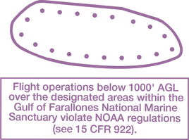
National Oceanic and Atmospheric Administration (NOAA) Marine Areas
These are depicted off the coast as magenta dotted outlined areas.
Pilots of all aircraft are required to operate above a minimum altitude as charted, usually 1,000 to 2,000 ft. AGL in these areas.
Because this altitude is above 400 ft. AGL, remote pilots should not consider operating in these areas.

Slide 33
Airspace Categories
The two categories of airspace are regulatory and nonregulatory.
Within these two categories, there are four types:
Controlled
Uncontrolled
Special use
Other airspace
The categories and types of airspace are dictated by the complexity or density of aircraft movements, nature of the operations conducted within the airspace, the level of safety required, and national and public interest.

Slide 34
Airspace Categories
Controlled airspace is defined as an area within which ATC service is provided to IFR and VFR flights in accordance with the airspace classification.
Controlled airspace is designated as Class A, Class B, Class C, Class D, and Class E airspace.
Uncontrolled airspace is designated as Class G airspace.
The distinction between uncontrolled airspace and the various types of controlled airspace relates to the following factors:
ATC clearance requirements
Pilot qualification requirements (as it relates to manned aircraft)
VFR flight visibility and distance from clouds requirement

Slide 35
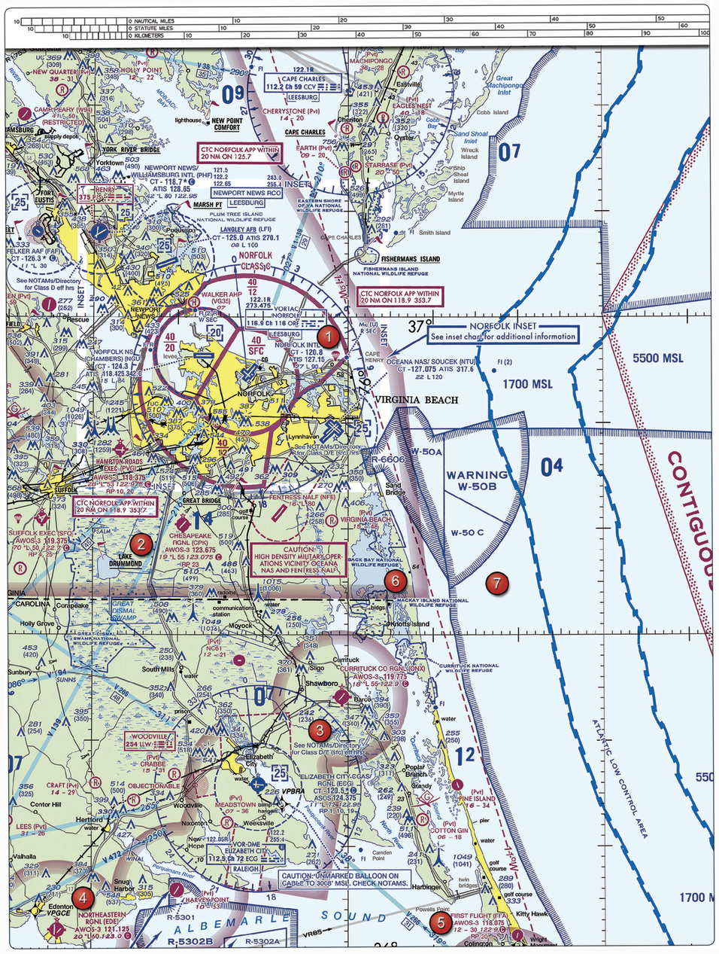
Checkpoint
(Refer to Area 5.) How would a remote PIC “CHECK NOTAMS” as noted in the CAUTION box regarding the unmarked balloon?
A. By contacting the FAA district office.
B. By utilizing the B4UFLY mobile application.
C. By obtaining a briefing via an online source such as: 1800WXBrief.com.
Notes:
🍐 This is a Pear Deck Drawing Slide
🍐 To edit the type of question, go back to the "Ask Students a Question" in the Pear Deck sidebar.
C

Slide 36
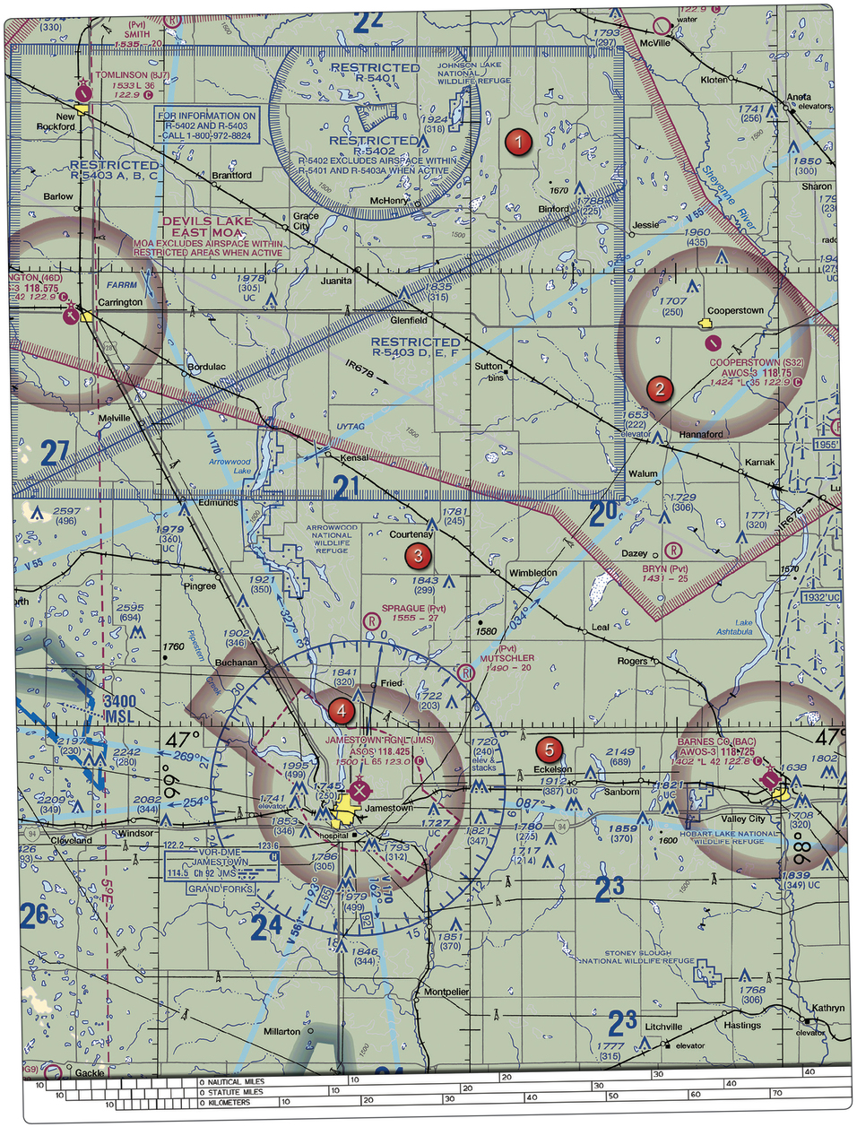
Checkpoint
(Refer to Area 2.) Identify the airspace over Bryn Airport.
A. Class G airspace -- surface up to but not including 1,200 feet AGL; Class E airspace -- 1,200 feet AGL up to but not including 18,000 feet MSL.
B. Class G airspace -- surface up to but not including 700 feet MSL; Class E airspace -- 700 feet to 14,500 feet MSL.
C. Class G airspace -- surface up to but not including 18,000 feet MSL.
Notes:
🍐 This is a Pear Deck Drawing Slide
🍐 To edit the type of question, go back to the "Ask Students a Question" in the Pear Deck sidebar.
Answer (A) is correct. (ACL) ( ? )
Bryn Airport is located 1.5 in. south of 2 on Fig. 26. There is no specific airspace designation around Bryn. Therefore, the airspace over the airport is Class G airspace up to the next overlying airspace. Unless the floor is designated otherwise, Class E airspace exists from 1,200 ft. AGL, up to but not including 18,000 ft. MSL.

