Slide 1
Math Review

Slide 2
What skills do I need to be successful in physics?
Basic Math Skills
Taking accurate measurements
Making and interpreting graphs
Scientific Method

Slide 3
I Love Math! How Much Do I Get To Do?
Math is the language of physics.
No new Math……..
………..but……………
You’ll need to use the math you’ve already learned.

Slide 4
Mr. G’s Problem Solving Strategy a.k.a. G.U.E.S.S. Method
Read the problem. Seriously, actually READ the problem all the way through!
Annotate (that means underline or highlight) the important information.
Identify and chart the known and unknown values.
Determine which formula you need to solve the problem.
Isolate the unknown variable on one side of the equal sign.
Insert the known values into the formula.
Solve the problem.

Slide 5
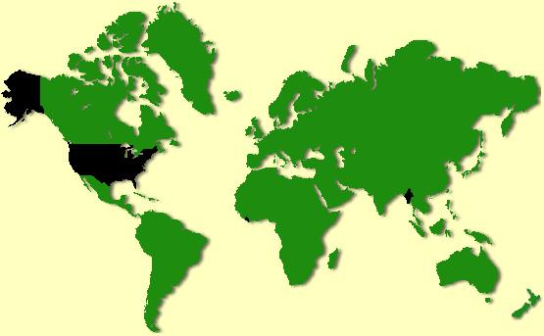
Don’t Use Four-Letter Words in Physics!
Inch
Foot
Yard
Mile

Slide 6
SI Units
Fundamental
Units

Slide 7
Dimensional Analysis
Use units to check your work.
Units tell you if formulas are set up correctly.
Conversion factors
$1000m=1km, 1=\frac{1km}{1000m}, 1=\frac{1000m}{1km}$

Slide 8

Dimensional Analysis
Convert 472 grams to kilograms.
$472g x \frac{1kg}{1000g}=0.472kg$

Slide 9
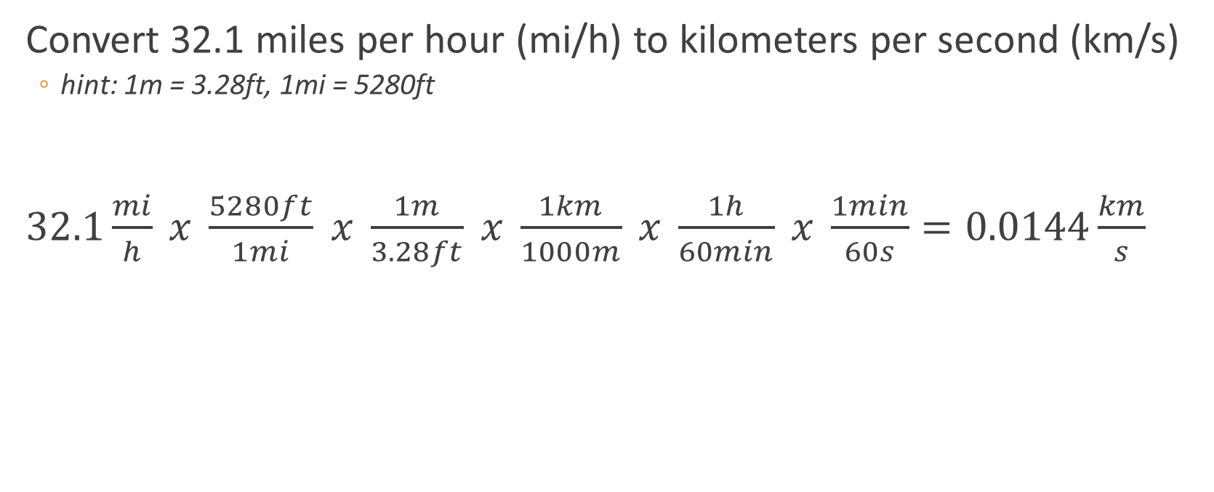
Dimensional Analysis
Convert 32.1 miles per hour (mi/h) to kilometers per second (km/s)
hint: 1m = 3.28ft, 1mi = 5280ft
$32.1\frac{mi}{h} x \frac{5280ft}{1mi} x \frac{1m}{3.28ft} x \frac{1km}{1000m} x \frac{1h}{60min} x \frac{1min}{60s}=0.0144\frac{km}{s}$

Slide 10
Try a Couple on Your Own!
Convert 2.67 liters to milliliters
Convert 3.61 yards to meters (1 inch = 2.54 cm)

Slide 11
Accuracy vs. Precision
Accuracy
The closeness of a measurement to its actual value.
Precision
The closeness of a measurement to other measurements obtained in exactly the same way.

Slide 12

Significant Figures
How much can you trust the numbers you get from a calculator?
$5.75x6.125=35.21875$
$5.75x6.126=35.2$245
$5.75x6.123=35.20725$

Slide 13
Significant Figures
Digits from 1-9 are always significant.
Zeros between nonzero digits are significant.
Zeros to the right of the decimal and a significant figure are significant.
Zeros used for placing the decimal point are not significant.

Slide 14
Significant Figures
Multiplication and Division
When multiplying or dividing, the answer may only show as many significant digits as the multiplied or divided measurement showing the least number of significant digits.
Addition and Subtraction
When adding or subtracting your answer can only show as many decimal places as the measurement having the fewest number of decimal places.

Slide 15
Scientific Notation
Multiplication and Division
(7.2 x 10³) x (3.0 x 10⁵)
21.6 x 10⁸
2.16 x 10⁹
2.2 x 10⁹

Slide 16
Scientific Notation
Addition and Subtraction
(6.3 x 10⁵) + (3.25 x 10⁶)
(0.63 x 10⁶) + (3.25 x 10⁶)
3.88 x 10⁶
3.9 x 10⁶

Slide 17
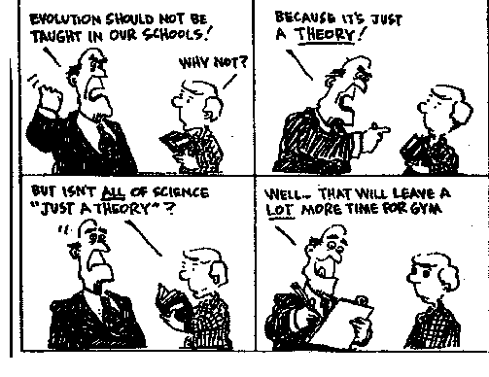
Scientific Method

Slide 18
Scientific Method
Hypothesis
An educated, testable guess
Scientific Theory
An explanation or model based on observation, experimentation, and reasoning.
Scientific Law
A phenomenon of nature that has been proven to invariably occur whenever certain conditions exist or are met

Slide 19
Scientific Method
Observation
Question
Negative
Revise
Hypothesis
Hypothesis
Positive
Experiment
Retest
Analysis
Theory

Slide 20
Graphs
Why do we use graphs in science?
Good way to visually represent data
Easier to see
Trends
Relationships between data points
Easier to understand
One of the most important tools used by scientists

Slide 21
Types of Graphs
Line Graph
Shows how a sample of data changes over time
Can show how a single data point changes over time or how multiple data points change over time

Slide 22
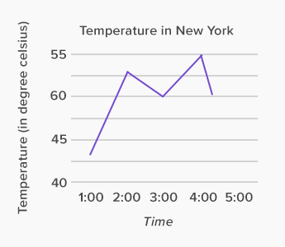
Line Graph

Slide 23
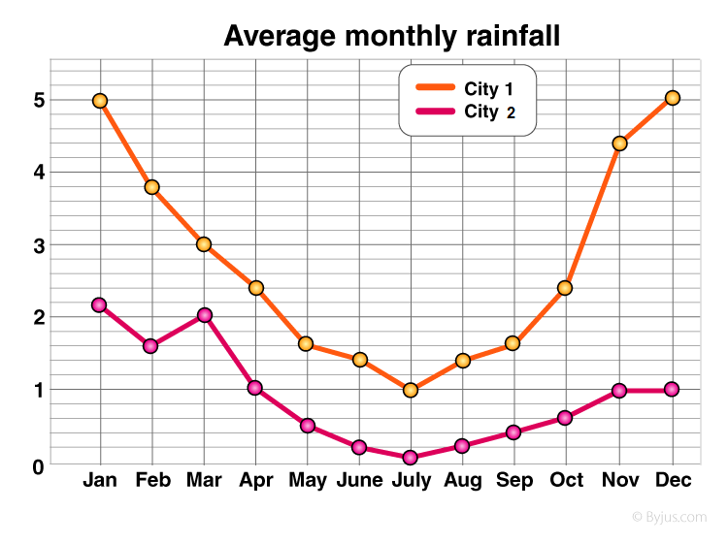
Line Graph

Slide 24
Bar Graph
Used to show quantities of frequencies.
Good for making comparisons
Can also be used to show changes over time
Time intervals should be larger

Slide 25
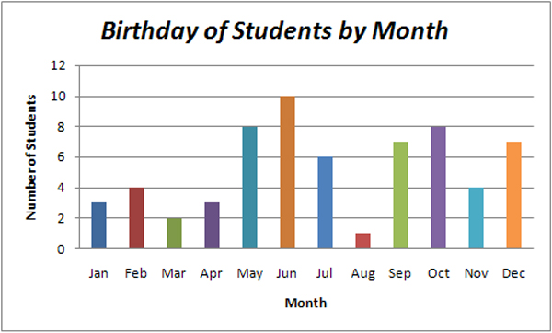
Bar Graph

Slide 26
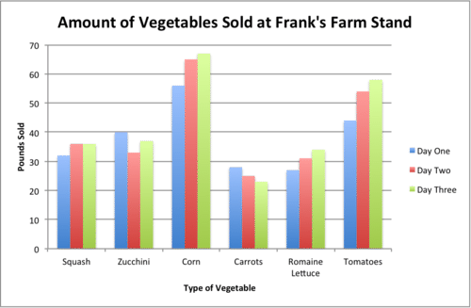
Bar Graph

Slide 27
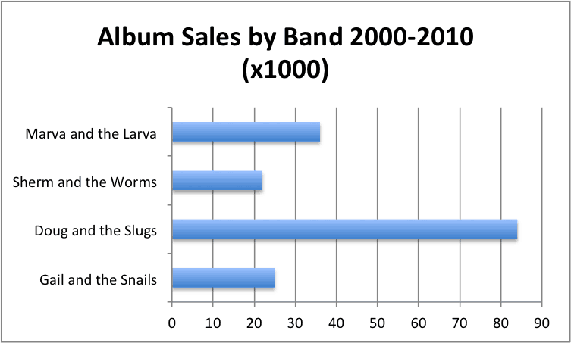
Bar Graph

Slide 28
Pie Chart
Used to show percent of a whole
Not commonly used

Slide 29
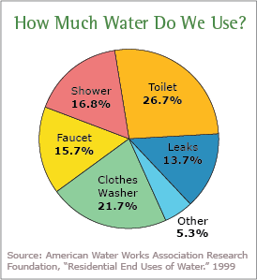
Pie Chart

Slide 30
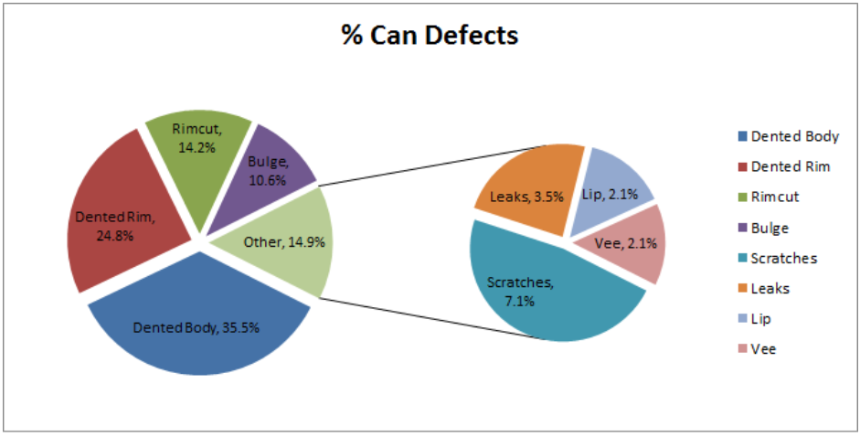
Pie Chart

Slide 31
Scatter Plot
Shows relationships between two variables
Most of the graphs you make in this class will be scatter plots.

Slide 32
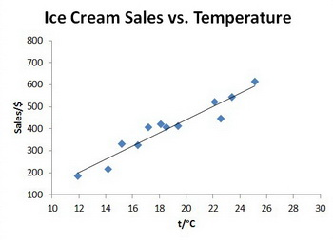
Scatter Plot

Slide 33
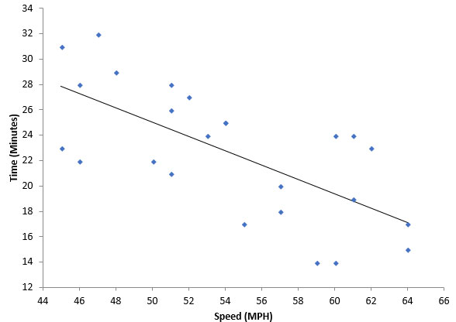
Scatter Plot

Slide 34
How to Create a Graph
Independent Variable – The variable that is changed by the researcher
Goes on the x-axis
Dependent Variable – The variable that is measured by the researcher
Goes on the y-axis

Slide 35
Elements of a Graph
Graph Title
Should convey the purpose of the graph
Axis Titles
Both x and y axes must have titles
Units MUST be included for numerical values
Ex: seconds (s), centimeters (cm), temperature (⸰C)

Slide 36
Elements of a Graph
Trendline
The best line that fits through all of the data points
Doesn’t need to go through the data points
Shows trends between variables on a scatter plot
Also called a line of best fit

Slide 37
Drawing Graphs by Hand
Need to be NEAT and easy to read
Lines and axes should always be drawn with a ruler
Scale should be uniform throughout
Graph should fill as much of page as possible

