Slide 1
Motion in One Dimension

Slide 2
Distance
We all know what the distance between two objects is...
So what is it?
What is distance?
What is length?
ALSO - you can't use the words "distance" or "length" in your definition; that would be cheating.

Slide 3
Distance
As you can see from your efforts, it is impossible to define distance.
Distance is a fundamental part of nature. It is so fundamental that it's impossible to define. Everyone knows what distance is, but no one can really say what it is.
However, distances can be compared.

Slide 4
Distance
We can compare the distance between two objects to the distance between two other objects.
For convenience, we create standard distances so that we can easily make comparisons... and tell someone else about them.
We will be using the meter as our unit for measuring distance. It's just that it's been accepted as a universal standard, so everyone knows what it is.
This doesn't define distance, but it allows us to work with it.

Slide 5
Distance
We'll be using meter as our standard for measuring distance.
The symbol for distance is "d".
And the unit for the meter is "m“.
d = 0.2 m

Slide 6
Time
Similarly, everyone knows what time is...
But try defining it; what is time?
Remember you can't use the word "time"
or an equivalent to the word "time", in your definition.

Slide 7
Time
Like distance, time is a fundamental aspect of nature.
It is so fundamental that it's impossible to define. Everyone knows what time is, but no one can really say what it is...
However, like distances, times can be compared.

Slide 8
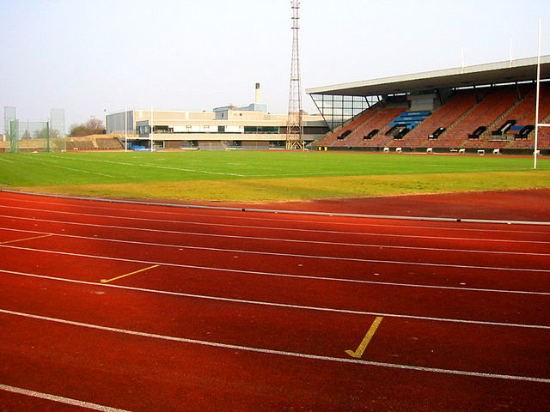
Time
We can say that in the time it took to run around the track, the second hand of my watch went around once...so my run took 60 seconds. When we compare the time between two events to the time between two other events, we are measuring time.
This doesn't define time, but it allows us to work with it.

Slide 9
Time
We will be using the second as our standard for measuring time.
The symbol for time is "t"
The unit for a second is "s".
t = 10s
click here for a "minute physics"
on measuring time and distance

Slide 10
Speed
Speed is defined as the distance traveled divided by the
time it took to travel that distance.
speed = distance
time
s = d
t
Speed is not a fundamental aspect of nature, it is the ratio of two things that are.

Slide 11
Speed
The units of speed can be seen by substituting the units for distance and time into the equation
s = d
t
meters
second
m
s
We read this unit as
"meters per second"

Slide 12
1
A car travels at a constant speed of 10m/s. This means the car:
A
c
increases its speed by 10m every second.
c
decreases its speed by 10m every second.
B
C
c
moves with an acceleration of 10 meters
every second.
D
c
moves 10 meters every second.

Slide 13
2
A rabbit runs a distance of 60 meters in 20 s; what is the speed of the rabbit?

Slide 14
3
A car travels at a speed of 40 m/s for 4.0 s; what is the distance traveled by the car?

Slide 15
4
You travel at a speed of 20m/s for 6.0s; what distance have you moved?

Slide 16
5
An airplane on a runway can cover 500 m in 10 s; what is the airplane's average speed?

Slide 17
You travel at a constant speed of 20 m/s; how much time does it take you to travel a distance of 120m?
6

Slide 18
7
You travel at a constant speed of 30m/s; how much time does it take you to travel a distance of 150m?

Slide 19
Average Speed
Return to
Table of
Contents

Slide 20
Average Speed
The speed we have been calculating is a constant speed over a short period of time. Another name for this is instantaneous speed.
If a trip has multiple parts, each part must be treated separately. In this case, we can calculate the average speed for a total trip.
Determine the average speed by finding the total distance you traveled and dividing that by the total time it took you to travel that distance.

Slide 21
Distance and Time Intervals
In physics we use subscripts in order to avoid any confusion with different distances and time intervals.
For example: if an object makes a multiple trip that has three parts we present them as d₁, d₂, d₃ and the corresponding time intervals t₁, t₂, t₃.

Slide 22
Average Speed & Non-Uniform Motion
The following pattern of steps will help us to find the average speed:
Find the total distance d_{total} = d₁+ d₂+ d₃
Find the total time t_{total} = t₁ + t₂ + t₃
Use the average speed formula
s_{avg} = d_{total}
t_{total}

Slide 23
Average Speed - Example 1
You ride your bike home from school by way of your friend’s house. It takes you 7 minutes (420 s) to travel the 2500 m to his house. You spend 10 minutes (600 s) there, before traveling 3500 m to your house in 9 minutes (540 s). What was your average speed for this trip?
To keep things clear, we can use a table to keep track of the information...

Slide 24
Example 1 - Step 1
Write the given information in the table below:
You ride your bike home from school by way of your friend’s house. It takes you 7 minutes (420 s) to travel the 2500 m to his house. You spend 10 minutes (600 s) there, before traveling 3500 m to your house in 9 minutes (540 s). What was your average speed for this trip?
Segment | Distance | Time | Speed
 | (m) | (s) | (m/s)
I
II
III
Total /Avg.

Slide 25
Example 1 - Step 2
Next, use the given information to find the total distance and total time
Segment | Distance | Time | Speed
 | (m) | (s) | (m/s)
I | 2500m | 420 s
II | 0 m | 600 s
III | 3500m | 540 s
Total /Avg.
You ride your bike home from school by way of your friend’s house. It takes you 7 minutes (420 s) to travel the 2500 m to his house. You spend 10 minutes (600 s) there, before traveling 3500 m to your house in 9 minutes (540 s). What was your average speed for this trip?

Slide 26
Example 1 - Step 2
Next, use the given information to find the total distance and total time
Segment | Distance | Time | Speed
 | (m) | (s) | (m/s)
I | 2500m | 420 s
II | 0 m | 600 s
III | 3500m | 540 s
Total /Avg. | 6000m | 1560s
You ride your bike home from school by way of your friend’s house. It takes you 7 minutes (420 s) to travel the 2500 m to his house. You spend 10 minutes (600 s) there, before traveling 3500 m to your house in 9 minutes (540 s). What was your average speed for this trip?

Slide 27
Example 1 - Step 3
Next use total distance and time to find average speed.
Segment | Distance | Time | Speed
 | (m) | (s) | (m/s)
I | 2500m | 420 s
II | 0 m | 600 s
III | 3500m | 540 s
Total /Avg. | 6000m | 1560s
You ride your bike home from school by way of your friend’s house. It takes you 7 minutes (420 s) to travel the 2500 m to his house. You spend 10 minutes (600 s) there, before traveling 3500 m to your house in 9 minutes (540 s). What was your average speed for this trip?

Slide 28
Example 1 - Solution
Next use total distance and time to find average speed.
Segment | Distance | Time | Speed
 | (m) | (s) | (m/s)
I | 2500m | 420 s
II | 0 m | 600 s
III | 3500m | 540 s
Total /Avg. | 6000m | 1560s | 3.85 m/s
You ride your bike home from school by way of your friend’s house. It takes you 7 minutes (420 s) to travel the 2500 m to his house. You spend 10 minutes (600 s) there, before traveling 3500 m to your house in 9 minutes (540 s). What was your average speed for this trip?

Slide 29
Example 2
Segment | Distance | Time | Speed
 | (m) | (s) | (m/s)
I
II
III
Total /Avg.
You run a distance of 210 m at a speed of 7 m/s. You then jog a distance of
800 m in a time of 235 s. Finally, you run for 25s at a speed of 6 m/s. What was the average speed of your total run?

Slide 30
Example 2 - Reflection
Segment | Distance | Time | Speed
 | (m) | (s) | (m/s)
I | 210 | 30 | 7
II | 800 | 235 | 3
III | 150 | 25 | 6
Total /Avg. | 1160 | 290 | 4
What happens when you take the 'average' (arithmetic mean) of the speed for each leg of the trip? Is it the same as the average speed?
Why do you think this happens?

Slide 31
Position and Reference Frames
Return to
Table of
Contents

Slide 32
Position and Reference Frames
Speed, distance and time didn't require us to define where we started and where we ended up. They just measure how far we traveled and how long it took to travel that far.
However, much of physics is about knowing where something is and how its position changes with time.
To define position we have to use a reference frame.

Slide 33
Position and Reference Frames
A reference frame lets us define where an object is located, relative to other objects.
For instance, we can use a map to compare the location of different cities, or a globe to compare the location of different continents.
However, not every reference frame is appropriate for every problem.

Slide 34
Reference Frame Activity
Send a volunteer out of the classroom to wait for further instructions.
Place an object somewhere in your classroom. Write specific directions for someone to be able to locate the object
Write them in a way that allows you to hand them to someone who can then follow them to the object.
Test your directions out on your classmate, (who is hopefully still in the hallway!)
Remember: you can't tell them the name of something your object is near, just how they have to move to get to it. For instance 'walk to the SmartBoard' is not a specific direction.

Slide 35
Reference Frame Activity - Reflection
In your groups, make a list of the things you needed to include in your directions in order to successfully locate the object in the room.
As a class, discuss your findings.

Slide 36
Results - Reference Frames
You probably found that you needed:
A starting point (an origin)
A set of directions (for instance left-right, forward-backward, up-down)
A unit of measure (to dictate how far to go in each direction)

Slide 37
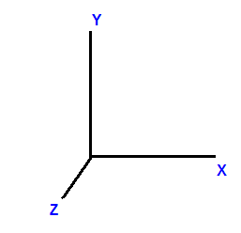
Results - Reference Frames
In this course, we'll usually:
Define the origin as a location labeled "zero"
Create three perpendicular axes : x, y and z for direction
Use the meter as our unit of measure

Slide 38
The Axis
In this course, we will be solving problems in one-dimension.
Typically, we use the x-axis for that direction.
+x will usually be to the right
-x would then be to the left
We could define it the opposite way, but unless specified otherwise, this is what we'll assume. We also can think about compass directions in terms of positive and negative. For example, North would be positive and South negative.
The symbol for position is "x".
- x
+x

Slide 39
8
All of the following are examples of positive direction except:
A
to the right
north
B
C
west
D
up

Slide 40
Displacement
Return to
Table of
Contents

Slide 41
Displacement
Now that we understand how to define position, we can talk about a change in position; a displacement.
The symbol for "change" is the Greek letter "delta" "Δ".
So "Δx" means the change in x or the change in position

Slide 42
Displacement
Displacement describes how far you are from where you started, regardless of how you got there.
+y
-x
+x
-y

Slide 43
Displacement
+y
For instance, if you drive 60 miles from Pennsylvania to New Jersey...
-x
x₀
+x
(In physics, we label the starting position x₀)
-y

Slide 44
Displacement
+y
and then 20 miles back toward Pennsylvania.
-x
x₀
x_{f}
+x
(We also label the final position x_{f} )
-y

Slide 45
Displacement
You have traveled:
a distance of 80 miles, and
a displacement of 40 miles,
since that is how far you are from where you started
+y
-x
x₀
x_{f}
+x
-y
we can calculate displacement with the following formula:
Δx = X_{f} - X_{o}

Slide 46
Displacement
Measurements of distance can only be positive values (magnitudes) since it is impossible to travel a negative distance.
Imagine trying to measure a negative length with a meter stick...

Slide 47
Displacement
However, displacement can be positive or negative since you can end up to the right or left of where you started.
+y
+y
-x
x_{o}
x_{f}
+x
-x
x_{f}
x_{o}
+x
-y
-y
Displacement is positive.
Displacement is negative.

Slide 48
Vectors and Scalars
Scalar - a quantity that has only a magnitude (number or value)
Vector - a quantity that has both a magnitude and a direction
Which of the following are vectors? Scalars?
Quantity | Vector | Scalar
Time
Distance
Displacement
Speed

Slide 49
9
How far your ending point is from your starting point is known as:
A
distance
B
displacement
C
a positive integer
D
a negative integer

Slide 50
A car travels 60m to the right and then 30m to the left. What distance has the car traveled?
10
- x
+x

Slide 51
11
You travel 60m to the right and then 30m to the left. What is the magnitude (and direction) of your displacement?
- x
+x

Slide 52
Starting from the origin, a car travels 4km east and then 7 km west. What is the total distance traveled?
12
A
3 km
B
-3 km
C
7 km
D
11 km

Slide 53
Starting from the origin, a car travels 4km east and then 7 km west. What is the net displacement from the original point?
13
3 km west
A
B
3 km east
C
7 km west
D
11 km east

Slide 54
14
You run around a 400m track. At the end of your run, what is the distance that you traveled?

Slide 55
15
You run around a 400m track. At the end of your run, what is your displacement?

Slide 56
Average Velocity
Return to
Table of
Contents

Slide 57
Average Velocity
Speed is defined as the ratio of distance and time
distance traveled
d
Average speed =
s =
time elapsed
t
Similarly, velocity is defined as the ratio of displacement and time
displacement
Δx
Average velocity =
v =
Δt
time elapsed

Slide 58
Average Velocity
Speeds are always positive, since speed is the ratio of distance and time; both of which are always positive.
distance traveled
d
Average speed =
s =
time elapsed
t
But velocity can be positive or negative, since velocity is the ratio of displacement and time; and displacement can be negative or positive.
displacement
Δx
Average velocity =
v =
Δt
time elapsed
Usually, right is positive and left is negative.

Slide 59
16
Which of the following is a vector quantity?
c
A
time
velocity
B
distance
c
C
D
speed

Slide 60
Average velocity is defined as change in ______ over a period of ______.
17
A
cc
distance, time
B
c
distance, space
C
c
displacement, time
D
c
displacement, space

Slide 61
19
You travel 60 meters to the right in 20 s; what is your average velocity?

Slide 62
20
You travel 60 meters to the left in 20 s; what is your average velocity?

Slide 63
21
You travel 60 meters to the left in 20 s and then you travel 60 meters to the right in 30 s; what is your average velocity?

Slide 64
You travel 60 meters to the left in 20 s and then you travel 60 meters to the right in 30 s; what is your average speed?
22

Slide 65
23
You run completely around a 400 m track in 80s. What was your average speed?

Slide 66
You run completely around a 400 m track in 80s. What was your average velocity?
24

Slide 67
25
You travel 160 meters in 60 s; what is your average speed?

Slide 68
26
You travel 160 meters in 60 s; what is your average speed?

Slide 69
Instantaneous Velocity
Return to
Table of
Contents

Slide 70
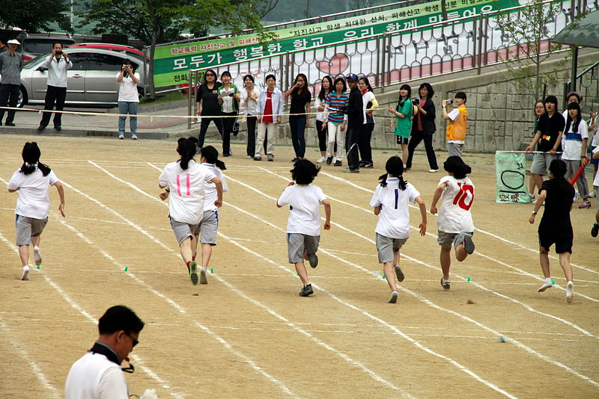
Instantaneous Velocity
Sometimes the average velocity is all we need to know about an object's motion.
For example:
A race along a straight line is really a competition to see whose average velocity is the greatest.
The prize goes to the competitor who can cover the displacement in the shortest time interval.
But the average velocity of a moving object can't tell us how fast the object moves at any given point during the interval Δt.

Slide 71
Instantaneous Velocity
Average velocity is defined as change in position over time. This tells us the 'average' velocity for a given length or span of time.
If we want to know the speed or velocity of an object at a specific point in time (with this radar gun for example), we want to know the instantaneous velocity...
Watch what happens when we look for the instantaneous velocity by reducing the amount of time we take to measure displacement.

Slide 72
Instantaneous Velocity
Displacement | Time
100m | 10 s
Velocity
In an experiment, an object travels at a constant velocity.
Find the magnitude of the velocity using the data above.

Slide 73
Instantaneous Velocity
10 m | 1 s
Displacement | Time | Velocity
100m | 10 s | 10 m/s
What happens if we measure the distance traveled in the same experiment for only one second?
What is the velocity?

Slide 74
Instantaneous Velocity
Displacement | Time | Velocity
100m | 10 s | 10 m/s
10 m | 1 s | 10 m/s
0.001m | 0.0001 s
What happens if we measure the distance traveled in the same experiment for a really small time interval?
What is the velocity?

Slide 75
Instantaneous Velocity
Displacement | Time | Velocity
100 m | 10 s | 10 m/s
10 m | 1 s | 10 m/s
1.0 m | 0.10 s | 10 m/s
0.10 m | 0.010 s | 10 m/s
0.010 m | 0.0010 s | 10 m/s
0.0010 m | 0.00010 s | 10 m/s
0.00010 m | 0.000010 s | 10 m/s
Since we need time to measure velocity, we can't know the exact velocity "at" a particular time... but if we imagine a really small value of time and the distance traveled, we can estimate the instantaneous velocity.

Slide 76
Instantaneous Velocity
To describe the motion in greater detail, we need to define the velocity at any specific instant of time or specific point along the path. Such a velocity is called instantaneous velocity.
Note that the word instant has somewhat different meaning in physics than in everyday language. Instant is not necessarily something that is finished quickly. We may use the phrase "It lasted just an instant" to refer to something that lasted for a very short time interval.

Slide 77
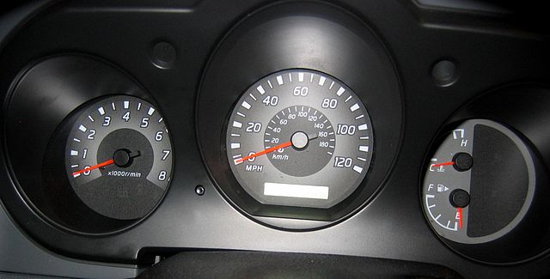
Instantaneous Velocity
In physics an instant has no duration at all;
it refers to a single value of time.
One of the most common examples we can use to understand instantaneous velocity is driving a car and taking a quick look on the speedometer.
At this point, we see the instantaneous value of the velocity.

Slide 78
Instantaneous Velocity
The instantaneous velocity is the same as the magnitude of the average velocity as the time interval becomes very very short.
Δx
v =
Δt as Δt 0

Slide 79
Velocity Graphing Activity
The graph below shows velocity versus time.
How do you know the velocity is constant?
v
(m/s)
t (s)

Slide 80
Velocity Graphing Activity
The graph below shows velocity versus time.
When is the velocity increasing? Decreasing? Constant?
v
(m/s)
t (s)

Slide 81
Velocity Graphing Activity
a.)
4
Use the graph to determine the Average Velocity of (a)
v
(m/s)
3
2
1
t (s)
b.)
4
v
(m/s)
3
2
1
1
t (s)

Slide 82
Velocity Graphing Activity
a.)
v
(m/s)
4
3
2
1
2
4
6
t (s)
Use the graph to determine the Average Velocity of (b)
b.)
v
(m/s)
4
3
2
1
1
2
4
6
t (s)

Slide 83
Velocity Graphing Activity
a.)
Use the graph to determine the Instantaneous Velocity of (a) at 2 seconds
v
(m/s)
4
3
2
1
2
4
6
t (s)
b.)
v
(m/s)
4
3
2
1
1
2
4
6
t (s)

Slide 84
Velocity Graphing Activity
a.)
v
(m/s)
4
3
2
1
2
4
6
t (s)
Use the graph to determine the Instantaneous Velocity of (b) at 2 seconds
b.)
v
(m/s)
4
3
2
1
1
2
4
6
t (s)

Slide 85
Instantaneous Velocity
These graphs show (a) constant velocity and (b) varying velocity.
(a) When the velocity of a moving object is a constant the instantaneous velocity is the same as the average.
v
(m/s)
t (s)
(b) When the velocity of a moving object changes its instantaneous velocity is different from the average velocity.
v
(m/s)
t (s)

Slide 86
Acceleration
Return to
Table of
Contents

Slide 87
Acceleration
Acceleration is the rate of change of velocity.
Δv
v - v_{o}
a =
a =
Δt
t
acceleration =
change of velocity
elapsed time

Slide 88
Acceleration
v - v_{o}
a =
t
Acceleration is a vector, although in one-dimensional motion we only need the sign.
Since only constant acceleration will be considered in this course, there is no need to differentiate between average and instantaneous acceleration.

Slide 89
Units for Acceleration
Units for acceleration
You can derive the units by substituting the correct units into the right hand side of these equations.
Δv
m/s
m/s²
a =
=
Δt
s

Slide 90
27
Acceleration is the rate of change of _________ .
c
A
displacement
c
B
distance
C
c
speed
D
c
velocity

Slide 91
28
The unit for velocity is:
c
A
m
c
B
m/s
C
c
m/s²
c
D
ft/s²

Slide 92
29
The metric unit for acceleration is:
c
A
m
c
B
m/s
c
C
m/s²
c
D
ft/s²

Slide 93
30
A horse gallops with a constant acceleration of
3m/s². Which statement below is true?
A
c
The horse's velocity doesn't change.
B
c
The horse moves 3m every second.
C
c
The horse's velocity increases 3m every second.
D
c
The horse's velocity increases 3m/s every second.

Slide 94
Solving Problems
After you read the problem carefully:
1. Draw a diagram (include coordinate axes).
2. List the given information.
3. Identify the unknown (what is the question asking?)
4. Choose a formula (or formulas to combine)
5. Rearrange the equations to isolate the unknown variable.
6. Substitute the values and solve!
7. Check your work.
(You can do the same operations to the units to check your work ... try it!)

Slide 95
Your velocity changes from 60 m/s to the right to 100 m/s to the right in 20 s; what is your average acceleration?
31

Slide 96
32
Your velocity changes from 60 m/s to the right to 20 m/s to the right in 20 s; what is your average acceleration?

Slide 97
Your velocity changes from 50 m/s to the left to 10 m/s to the right in 15 s; what is your average acceleration?
33

Slide 98
Your velocity changes from 90 m/s to the right to 20 m/s to the right in 5.0 s; what is your average acceleration?
34

Slide 99
Kinematics Equation 1
Return to
Table of
Contents

Slide 100
Motion at Constant Acceleration
Δv
but since "Δ" means change
Δv = v - v_{o} and
Δt = t - t_{o}
if we always let t_{o} = 0, Δt = t
Solving for "v"
This equation tells us how an object's velocity changes as a function of time.
a =
Δt
v - v_{o}
a =
t
at = v - v_{o}
_{v} - v_{o} = at
v = v_{o} + at

Slide 101
35
Starting from rest, you accelerate at 4.0 m/s² for 6.0s. What is your final velocity?

Slide 102
36
Starting from rest, you accelerate at 8.0 m/s² for 9.0s. What is your final velocity?

Slide 103
37
You have an initial velocity of 5.0 m/s. You then experience an acceleration of -1.5 m/s² for 4.0s; what is your final velocity?

Slide 104
38
You have an initial velocity of -3.0 m/s. You then experience an acceleration of 2.5 m/s² for 9.0s; what is your final velocity?

Slide 105
How much time does it take to accelerate from an initial velocity of 20m/s to a final velocity of 100m/s if your acceleration is 1.5 m/s²?
39

Slide 106
40
How much time does it take to come to rest if your initial velocity is 5.0 m/s and your acceleration is
-2.0 m/s²?

Slide 107
41
An object accelerates at a rate of 3 m/s² for 6 s until it reaches a velocity of 20 m/s. What was its initial velocity?

Slide 108
An object accelerates at a rate of 1.5 m/s² for 4 s until it reaches a velocity of 10 m/s. What was its initial velocity?
42

Slide 109
Graphing Motion at Constant Acceleration
In physics there is another approach in addition to algebraic which is called graphical analysis. The formula v = v₀ + at can be interpreted by the graph. We just need to recall our memory from math classes where we already saw a similar formula y = mx + b.
From these two formulas we can some analogies:
v ⇒ y (depended variable of x),
v₀ ⇒ b (intersection with vertical axis),
t ⇒ x (independent variable),
a ⇒ m ( slope of the graph- the ratio between rise and run Δy/Δx).

Slide 110
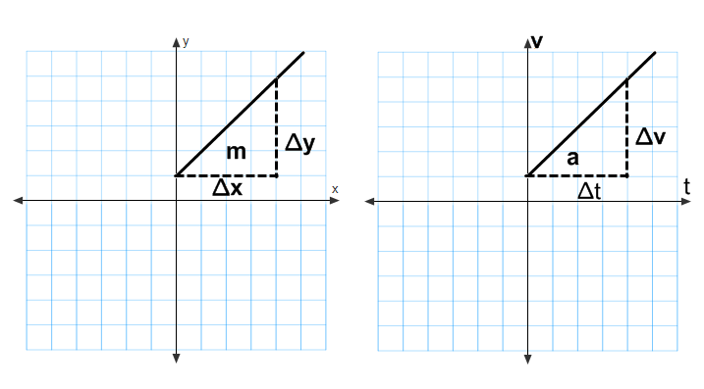
Motion at Constant Acceleration
Below we can find the geometric explanation to the acceleration a =Δv/Δt which is the same a the slope of a given graph.

Slide 111
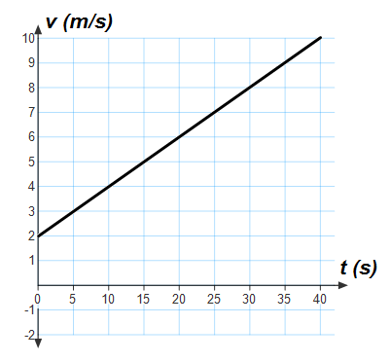
43
The velocity as a function of time is presented by the graph. What is the acceleration?

Slide 112
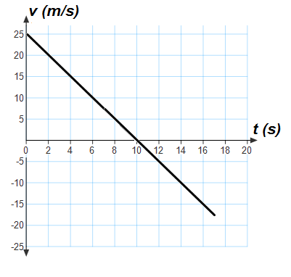
44
The velocity as a function of time is presented by the graph. Find the acceleration.

Slide 113
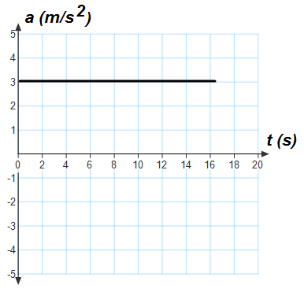
Motion at Constant Acceleration
The acceleration graph as a function of time can be used to find the velocity of a moving object. When the acceleration is constant the velocity is changing by the same amount each second. This can be shown on the graph as a straight horizontal line.
In order to find the change is velocity for a certain limit of time we need to calculate the area under the acceleration line that is limited by the time interval.

Slide 114
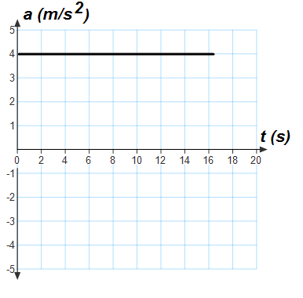
Motion at Constant Acceleration
The change in velocity during first 12 seconds is equivalent to the shadowed area
(4m x 12s = 48m).
s²
s
The change in velocity during first 12 seconds is 48 m/s.

Slide 115
The following graph shows acceleration as a function of time of a moving object. What is the change in velocity during first 10 seconds?
45

Slide 116
Free Fall:
Acceleration Due to Gravity
Return to
Table of
Contents

Slide 117
Free Fall
All unsupported objects fall towards Earth with the same acceleration. We call this acceleration the "acceleration due to gravity" and it is denoted by g.
g = 9.8 m/s²
Keep in mind, ALL objects accelerate towards the earth at the same rate.
g is a constant!

Slide 118
It stops momentarily.
v = 0
g = -9.8 m/s²
What happens at the top?
It speeds up
(negative acceleration)
g = -9.8 m/s²
What happens when it goes down?
It slows down.
(negative acceleration)
g = -9.8 m/s²
What happens when it goes up?
An object is thrown upward with initial velocity, v_{o}
It returns with its
original velocity.
What happens when it lands?

Slide 119
It stops momentarily.
v = 0
g = -9.8 m/s²
It speeds up.
(negative acceleration)
g = -9.8 m/s²
It slows down.
(negative acceleration)
g = -9.8 m/s²
An object is thrown upward with initial velocity, v_{o}
It returns with its
original velocity.

Slide 120
On the way up:
On the way down:
v₀
v
a
t = 3 s
v₁
a
t = 0 s
v₂
a
t = 2 s
v₁
t = 1 s
v₂
a
a
v₁
v₂
t = 1 s
a
v₂
t = 2 s
v
v₀
a
v₁
t = 0 s
v
t = 3 s

Slide 121
An object is thrown upward with initial velocity, v_{o}
For any object thrown straight up into the air, this is what the velocity vs time graph looks like.
v
(m/s)
It stops momentarily.
v = 0
g = -9.8 m/s²
t (s)
It returns with its
original velocity but in the opposite direction.

Slide 122
46
A ball is dropped from rest and falls (do not consider air resistance). Which is true about its motion?
A
c
acceleration is constant
c
B
velocity is constant
C
c
velocity is decreasing
D
c
acceleration is decreasing

Slide 123
An acorn falls from an oak tree. You note that it takes 2.5 seconds to hit the ground. How fast was it going when it hit the ground?
47

Slide 124
48
A rock falls off a cliff and hits the ground 5 seconds later. What velocity did it hit the ground with?

Slide 125
49
A ball is thrown down off a bridge with a velocity of 5 m/s. What is its velocity 2 seconds later?

Slide 126
An arrow is fired into the air and it reaches its highest point 3 seconds later. What was its velocity when it was fired?
50

Slide 127
A rocket is fired straight up from the ground. It returns to the ground 10 seconds later. What was it's launch speed?
51

Slide 128
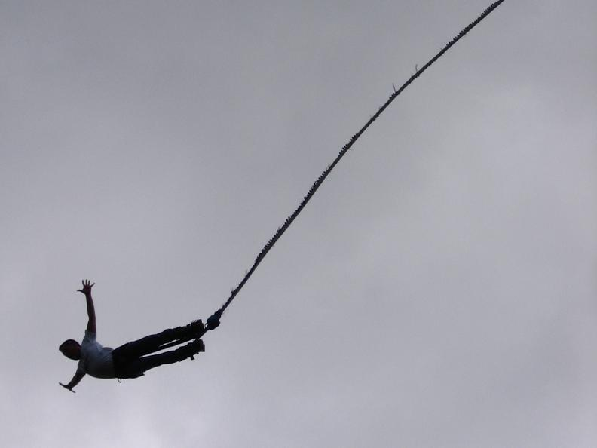
Acceleration of a Bungee Jump
Now take what you have just learned and contemplate a question about acceleration in the Veritasium video below:
Click here for the video

Slide 129
Motion at Constant Acceleration
If velocity is changing at a constant rate, the average velocity is just the average of the initial and final velocities.
v + v_{o}
v =
2
Δx
And we learned earlier that
v =
t
Δx
v + v_{o}
=
t
2
Some problems can be solved most easily by using these two equations together.
(v + v_{o})
Δx
=
t
2

Slide 130
Starting from rest you accelerate to 20 m/s in 4.0s. What is your average velocity?
52

Slide 131
Starting with a velocity of 12 m/s you accelerate to 48 m/s in 6.0s. What is your average velocity?
53

Slide 132
54
Starting with a velocity of 12 m/s you accelerate to 48 m/s in 6.0s. Using your previous answer, how far did you travel in that 6.0s?
Previous Answer
average velocity = 30 m/s

Slide 133
Kinematics Equation 2
Return to
Table of
Contents

Slide 134
Motion at Constant Acceleration
Δx
v + v_{o}
v = v_{o} + at
v =
t
v =
2
Δx
v
=
t
x - x_{o} = ½ (v + v_{o})t
x - x_{o} = ½vt + ½v_{o}t
x = x_{o} + ½v_{o}t + ½vt
x = x_{o} + ½v_{o}t + ½(v_{o} + at)t
x = x_{o} + ½v_{o}t + ½v_{o}t + ½at²
x = x_{o} + v_{o}t + ½at²
We can combine these three equations to derive an equation which will directly tell us the position of an object as a function of time.

Slide 135
Motion at Constant Acceleration
Graphical Approach
If the area under the graph is length x width
(A = lw), then:
A = v₀t Since we know that v = ,
then area is really Δx.
A = Δx = v₀t
v
(m/s)
Δx
t
A = lw
t (s)

Slide 136
Motion at Constant Acceleration
Graphical Approach
v
(m/s)
If the area under this graph is ½ base x height, then:
A = ½ t Δv Since we know that a = ,
Δv = at.
A = Δx = ½t(at) = ½at²
Δv
t
A = ½bh
t (s)

Slide 137
Motion at Constant Acceleration
Graphical Approach
v
(m/s)
Therefore, the area under a velocity vs. time graph is displacement. It can be calculated by combining the previous two results.
A = Δx = v₀t + ½at²
x - x₀ = v₀t + ½at²
x = x₀ + v₀t + ½at²
½at²
v₀t
t (s)

Slide 138
An airplane starts from rest and accelerates at a constant rate of 3.0 m/s² for 30.0 s before leaving the ground. How far did it move along the runway?
55

Slide 139
56
A Volkswagen Beetle moves at an initial velocity of 12 m/s. It coasts up a hill with a constant acceleration of –1.6 m/s². How far has it traveled after 6.0 seconds?

Slide 140
A motorcycle starts out from a stop sign and accelerates at a constant rate of 20 m/s². How long will it take the motorcycle to go 300 meters?
57

Slide 141
58
A train pulling out of Grand Central Station accelerates from rest at a constant rate. It covers 800 meters in 20 seconds. What is its rate of acceleration?

Slide 142
A car has a initial velocity of 45 m/s. It accelerates for 4.8 seconds. In this time, the car covers 264 meters. What is its rate of acceleration?
59

Slide 143
60
A Greyhound bus traveling at a constant velocity starts to accelerate at a constant 2.0 m/s². If the bus travels 500 meters in 20 seconds, what was its initial velocity?

Slide 144
Kinematics Equation 3
Return to
Table of
Contents

Slide 145
Motion at Constant Acceleration
We can also combine these equations so as to eliminate t:
v² = v_{o}² + 2a(x - x_{o})

Slide 146
A car accelerates from rest to 30m/s while traveling a distance of 20m; what was its acceleration?
61

Slide 147
You accelerate, from rest, at 10m/s² for a distance of 100m; what is your final velocity?
62

Slide 148
63
Beginning with a velocity of 25m/s, you accelerate at a rate of 2.0m/s². During that acceleration you travel 200m; what is your final velocity?

Slide 149
64
You accelerate from 20m/s to 60m/s while traveling a distance of 200m; what was your acceleration?

Slide 150
65
A dropped ball falls 8.0m; what is its final velocity?

Slide 151
A ball with an initial velocity of 25m/s is subject to an acceleration of -9.8 m/s²; how high does it go before coming to a momentary stop?
66

Slide 152
Mixed Kinematics Problems
Return to
Table of
Contents

Slide 153
Motion at Constant Acceleration
We now have all the equations we need to solve constant-acceleration problems.
v = v_{o} + at
x = x_{o} + v_{o}t + ½at²
v² = v_{o}² + 2a(x - x_{o})

Slide 154
Starting at the position, x₀ = 4 m, you travel at a constant velocity of +2 m/s for 6s.
a. Determine your position at the times of 0s; 2s; 5s; and 6s.
b. Draw the Position versus Time for your travel during this time.
c. Draw the Velocity versus Time graph for your trip.
67

Slide 155
Starting at the position, x₀ = 4 m, you travel at a constant velocity of +2 m/s for 6s.
a. Determine your position at the times of 0s; 2s; 5s; and 6s.

Slide 156
Starting at the position, x₀ = 4 m, you travel at a constant velocity of +2 m/s for 6s.
b. Draw the Position versus Time for your travel during this time.
X
(m)
t (s)

Slide 157
Starting at the position, x₀ = 4 m, you travel at a constant velocity of +2 m/s for 6s.
c. Draw the Velocity versus Time graph for your trip.
v
(m/s)
t (s)

Slide 158
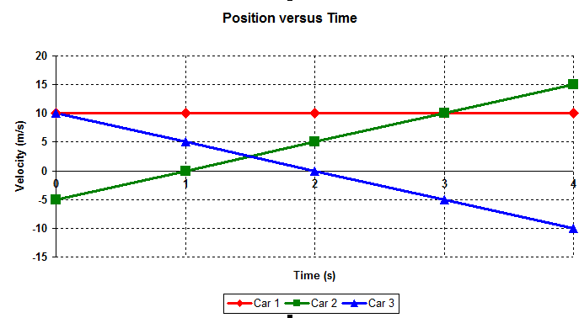
The position versus time graph, below, describes the motion of three different cars moving along the x-axis.
68
a. Describe, in words, the velocity of each of the cars. Make sure you discuss each car’s speed and direction.
Position (m)

Slide 159
69
The position versus time graph, below, describes the motion of three different cars moving along the x-axis.
b. Calculate the velocity of each of the cars.

Slide 160
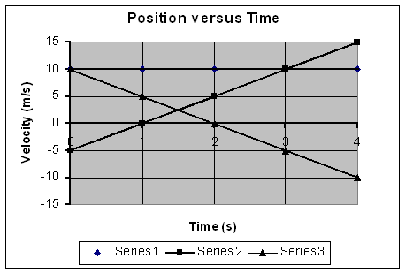
c. Draw, on one set of axes, the Velocity versus Time graph for each of the three cars.
v
(m/s)
Position (m)
t (s)

Slide 161
Summary
· Kinematics is the description of how objects move with respect to a defined reference frame.
· Displacement is the change in position of an object.
· Average speed is the distance traveled divided by the time it took; average velocity is the displacement divided by the time.

Slide 162
Summary (continued)
· Instantaneous velocity is the limit as the time becomes infinitesimally short.
· Average acceleration is the change in velocity divided by the time.
· Instantaneous acceleration is the limit as the time interval becomes infinitesimally small.

Slide 163
Summary (continued)
· There are four equations of motion for constant acceleration, each requires a different set of quantities.
v = v_{o} + at
x = x_{o} + v_{o}t + ½at²
v² = v_{o}² + 2a(x - x_{o})
v + v_{o}
v =
2

