Slide 1
Fluids
A fluid is anything that flows.
To prepare for this unit, we will start with density and pressure.

Slide 2
The student will investigate and understand properties of fluids.
Key concepts include
density and pressure
variation of pressure with depth
Archimedes’ principle of buoyancy
Pascal’s principle
fluids in motion
Bernoulli’s principle

Slide 3
Density, add to notes
Name something that has high density.
Name something that has low density.
Density is the mass divided by the volume.
The volume of a rectangular solid is length X width X height.
Mass is in grams or kg.
Volume is in ml, liters, or cm³
Water has a density of 1 g/cm³ or 1000 kg/m³ or 1 kg/liter.
Density is an intensive property of matter which means any size of the same sample will have the same density.

Slide 4
Salt water is denser than fresh water because a cup of salt water has more mass than 1 cup of fresh water.

Slide 5
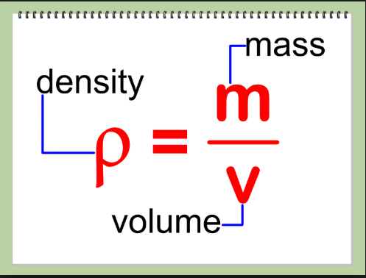

Slide 6
Density is the relationship
of the mass of an object to its volume.

Slide 7
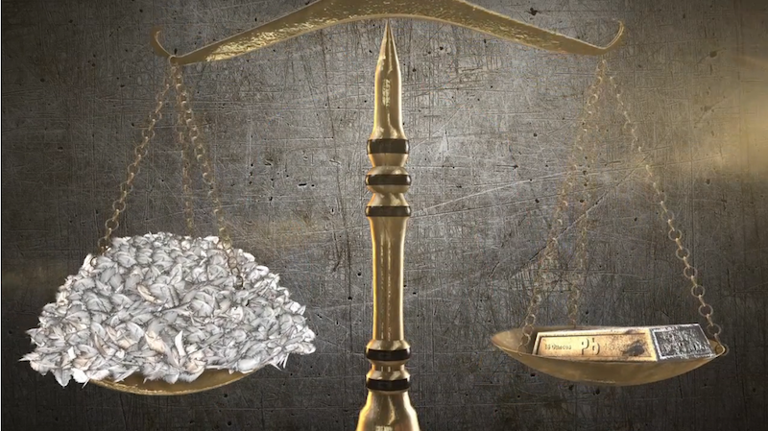
What is heavier, a pound of lead or a pound of feathers?
They both have the same weight.
The lead is denser.

Slide 8
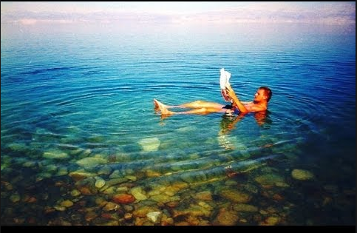
The dead sea is so salty that it is very dense. A person can float without a raft.

Slide 9
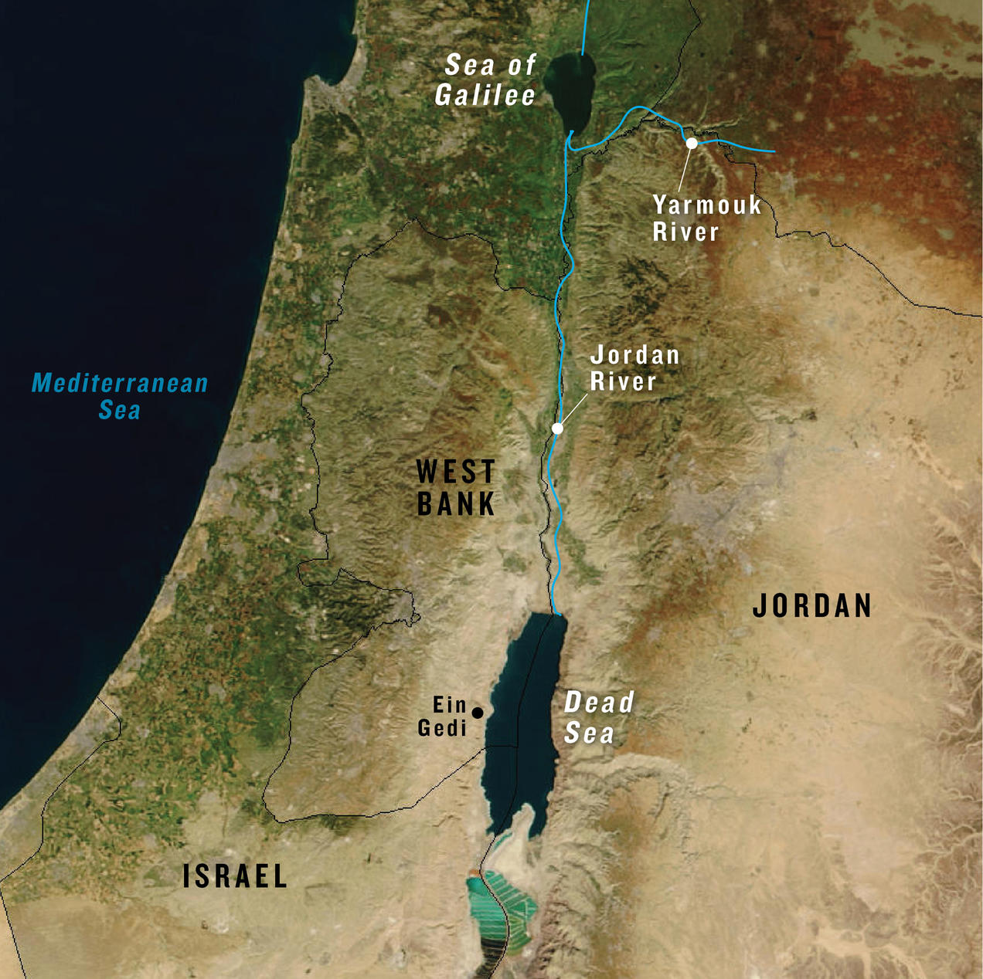
Here is a map to show you the location of the sea. Water flows in , but it doesn’t flow out. Much of the water evaporates in the dry climate, so the salt builds up.

Slide 10
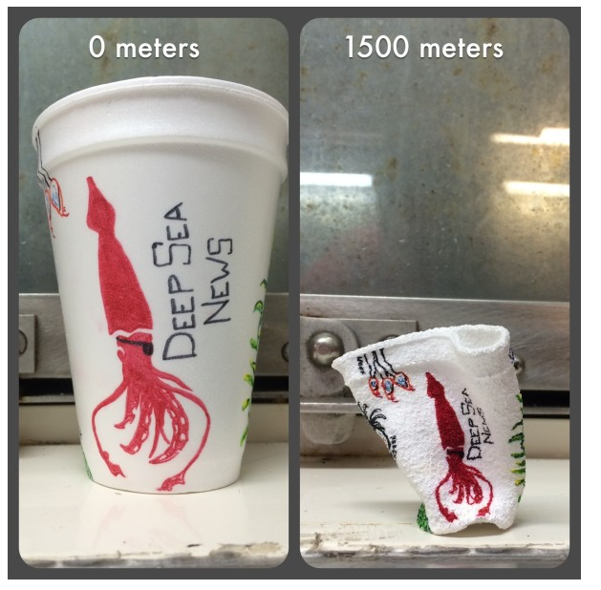
If an object like this cup is put under a lot of pressure, its density can increase. This cup was put down deep under water.

Slide 11
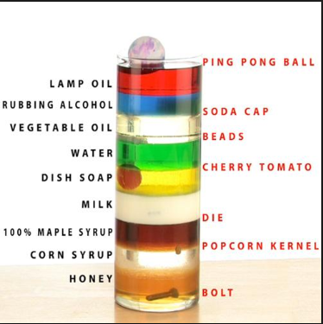
These substances stack up according to their density. The denser objects are below the less dense substances.

Slide 13
*
*unless a larger object has been
compressed to a smaller size.

Slide 15
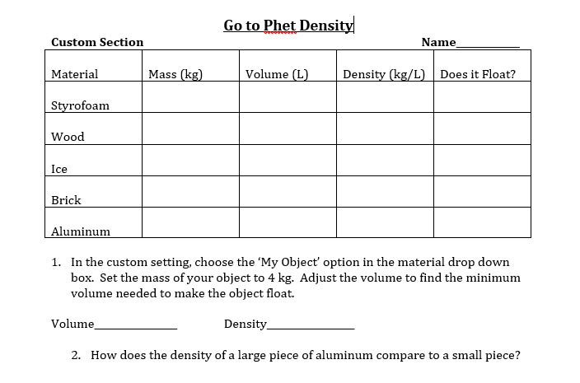
Google: Phet Density

Slide 16
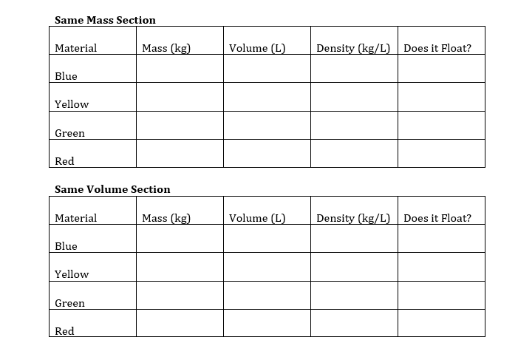

Slide 17
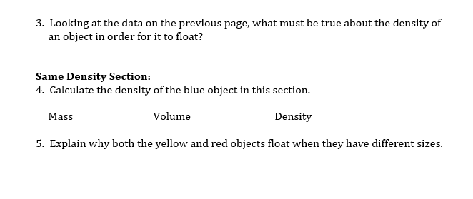

Slide 18
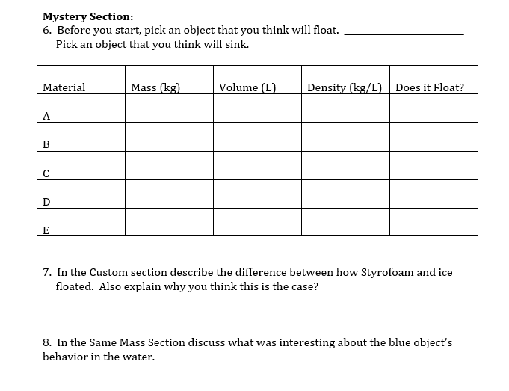

Slide 19
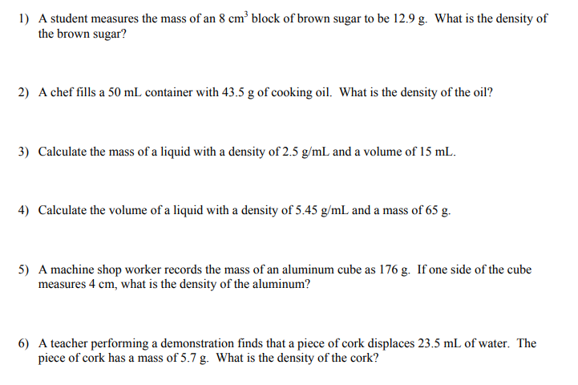
Density Practice Problems. This worksheet is also in student view in the grade book. I will put a help video there as well.

Slide 20
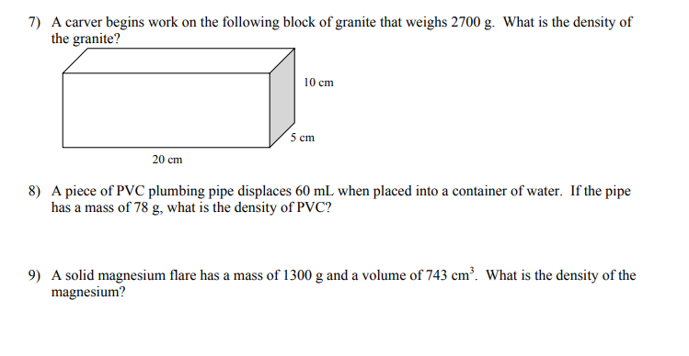

Slide 21
Define and apply the term pressure.
Calculate pressure.
Pressure is force divided by area.
More force increases pressure.
A larger area reduces pressure.
If you know the mass, you find the force by multiplying by g. (This will be the weight.)
Pressure is a vector.
The unit is Newtons/m² or Pascals.
If you need to find the area of a rectangular surface, you multiply length by width.

Slide 22
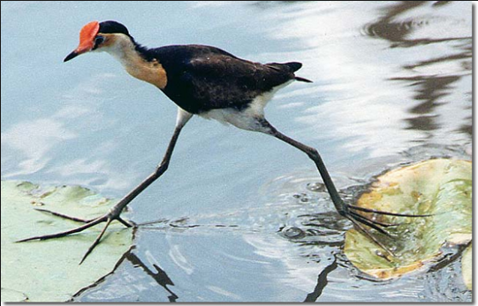
This bird can walk on the lily pads because there is very little pressure with those long toes.

Slide 23
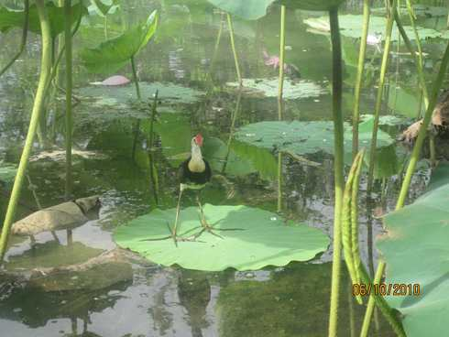

Slide 24
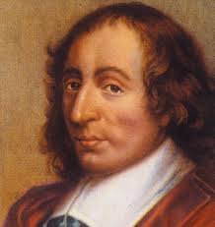
Pressure=force/area
Unit: N/m² or Pascal
Today’s objective:
5. Define and apply the term pressure.

Slide 25
F, force in newtons
P, pressure in pascals
A, Area in meters squared
f
P
a

Slide 26
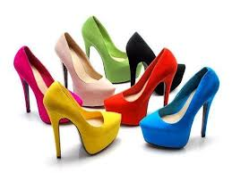
High pressure because very little of the shoe touches the ground.

Slide 27
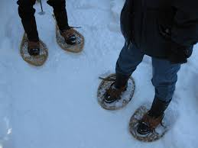
Low pressure because the snow shoes are very large. This helps keep them from sinking in the snow.

Slide 28
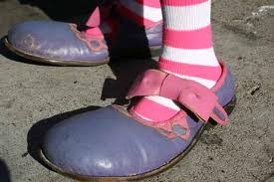
Low pressure, Very Big Shoes.

Slide 29
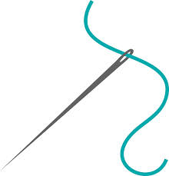
High Pressure because the point of a needle is very small.

Slide 30
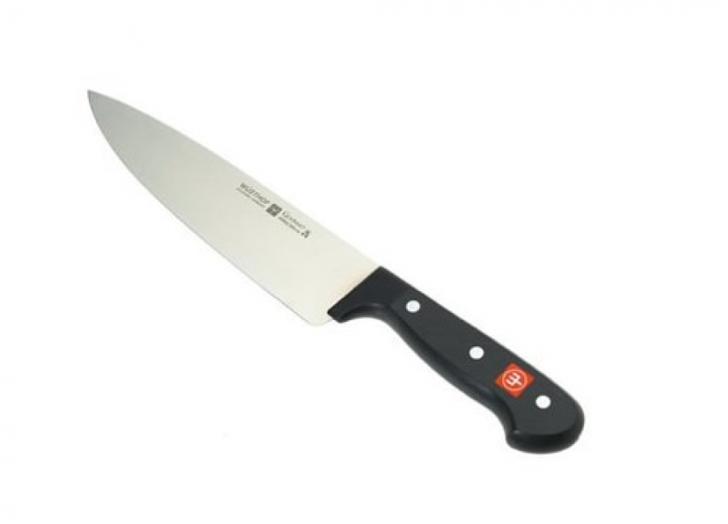
High pressure because the edge of the knife is very thin.

Slide 31
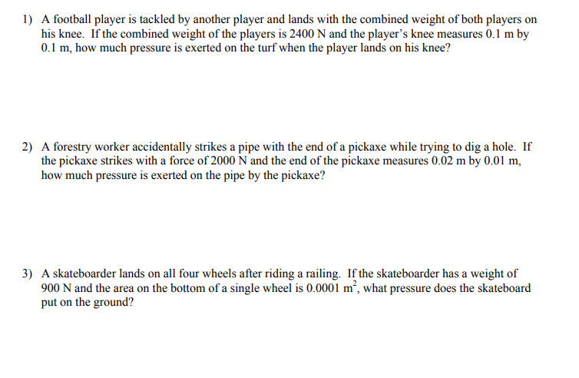
Do these pressure practice problems.
The worksheet is also in student view grade book along with a help video.

Slide 32
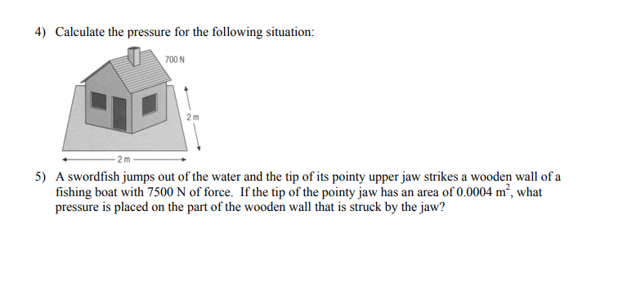

Slide 33
Foot pressure lab: How do the following compare in terms of pressure, a woman in high heels standing on 2 feet, an elephant standing on 4 feet and a person on two bare feet?
How could you design a lab to find this out?
This is a lab that we usually do in class. Write a procedure for how you think these questions could be answered. You do not have to do the lab.
There are some pictures on the next slides that may give you some ideas on how to do it.

Slide 34
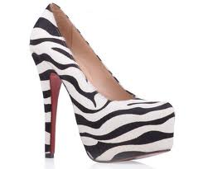

Slide 35
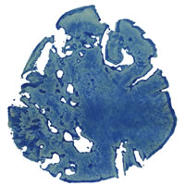
Asian elephant cow Chhukha's left front foot is around 40 cm long as well as wide, and has a circumference of 1.34 m. 4870 kg Zürich zoo's elephant bull
Maxie's left front foot is around 47 cm long and 51 cm wide, and has a circumference of 1.57 m.
5500 kg

Slide 36
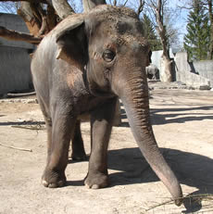
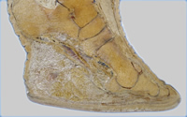
Chhukha
4870 kg

Slide 37
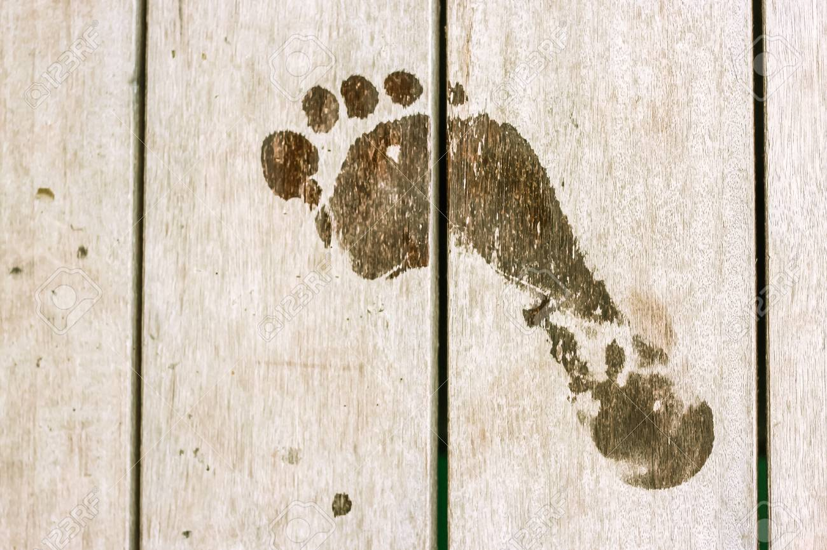
How could you find the pressure on this foot?

Slide 38
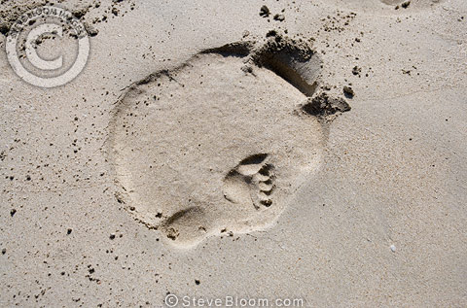
Rajan’s footprint with a man’s print. Radius is about 20 cm (8 inches) for the front feet and 25 cm (10 inches) for the back. His weight was 12000 lbs. This may be a back foot. Back feet have 3 toes.

Slide 39
Pressure in a fluid (like water or even air) increases when you are deeper in the fluid. Do this submarine lab to see how the pressure changes with depth.

Slide 40
Instructions on the next slide.
http://www.thephysicsaviary.com/Physics/Programs/Labs/DeepSeaDiverLab/

Slide 41
Go to Physics Aviary Deep Sea Diver Lab
Practice driving the sub and stopping for data. You have to hit the opposite arrows to stop.
Problem: How does pressure increase with depth in water?
Make a table.
Choose 7 different depths to record the pressure. Spread them out. I just drove my sub and stopped at 7 different places.
Use the pointy nose of the sub to measure the depth. Use the reading on the sub’s instrument panel to record the pressure.
Graph the depth on the x axis and the pressure on the y axis.
This should be a straight line. The equation is $∆P=ρg∆h$. P is pressure, $ρ$ is the density of the water, and h is height. Remember that $∆$ means change in.
Would you expect the pressure to increase more with fresh water or salt water? Explain.
Remember you can make a graph on Create a graph or Desmos.
Depth of Submarine (m) | Pressure of water (kPascals)

Slide 42
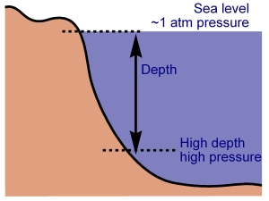

Slide 43
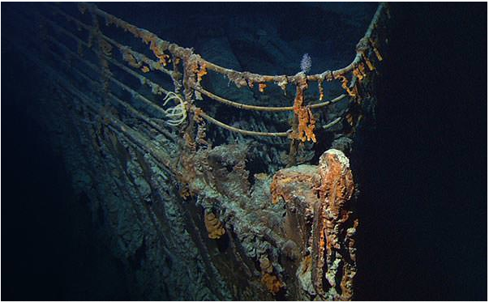
How deep is the Titanic wreck?
The wreck of the Titanic lies at a depth of approximately 2.4 miles (3.75 kilometres, or 12,600 feet).
The water pressure at the ocean floor where the Titanic came to rest is 377 times stronger than the pressure at the surface. As the stern section spiralled down this water pressure would have torn away sections of the hull and stripped much of the interior.

Slide 44
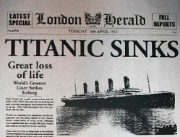
When was the Titanic found?
The wreck of the Titanic was finally located in 1985, on 01 September to be precise. She was discovered by an American-French team led by Robert Ballard and Jean-Louis Michel, and using the remote-controlled deep-sea submersible ‘Argo’. The wreck was found 73 years after it sank.
It sank
April 14,15, 1912.

Slide 45
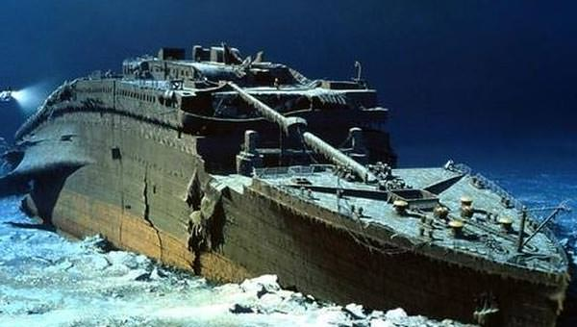

Slide 46
At sea level, the air that surrounds us presses down on our bodies at 14.5 pounds per square inch. You don't feel it because the fluids in your body are pushing outward with the same force.
.
https://www.stevespanglerscience.com/lab/experiments/incredible-can-crusher/

Slide 47
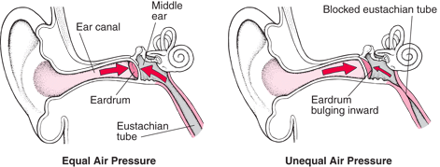
Dive down into the ocean even a few feet, though, and a noticeable change occurs. You can feel an increase of pressure on your eardrums. This is due to an increase in hydrostatic pressure, the force per unit area exerted by a liquid on an object.

Slide 48
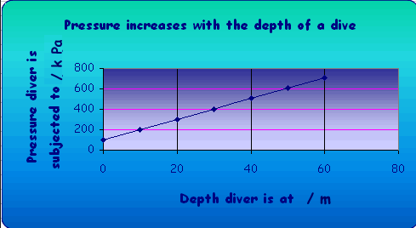
The deeper you go under the sea, the greater the pressure of the water pushing down on you. For every 33 feet (10.06 meters) you go down, the pressure increases by 14.5 psi.

Slide 49
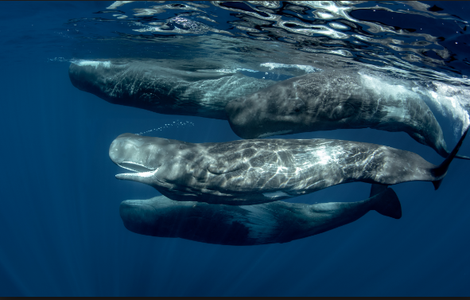
Many animals that live in the sea have no trouble at all with high pressure. Whales, for instance, can withstand dramatic pressure changes because their bodies are more flexible. Their ribs are bound by loose, bendable cartilage, which allows the rib cage to collapse at pressures that would easily snap our bones.
You do not need to take notes on the sea animals.

Slide 50
Emperor Penguin
The deepest diving of all seabirds, the emperor penguin feeds primarily on fish. However, their diet also includes deep-dwelling squid and other cephalopods. Records show that they’ve dived down to 1,755 feet (535 m) in pursuit of prey. The emperor penguin is perfectly adapted to survive these deep dives. Its wings are flatter and stiffer than those of other birds, enabling extra propulsion. Its bones are solid, rather than air-filled, to reduce the risk of barotrauma. These penguins can also slow their heart rate to just 15 to 20 beats per minute while diving in order to minimize oxygen use. To counter the icy temperatures of the Antarctic waters, emperor penguins have the highest feather density of any bird species, and a layer of sub-dermal fat measures over an inch thick.

Slide 51
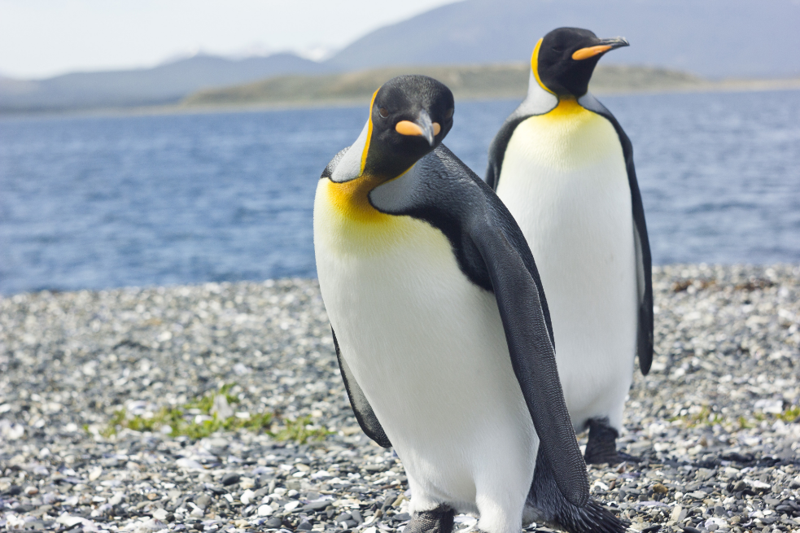

Slide 52
Leatherback Turtle
The leatherback turtle is unique among turtles in that its carapace is made of toughened skin — hence the name leatherback — rather than a bony shell. This adaptation gives the turtle added flexibility under pressure, and signals the leatherback’s status as one of the deepest diving animals. Scientists have recorded leatherbacks at depths of 4,200 feet (1,280 m), following the daily daylight migration of the jellyfish they eat. In order to cope with the incredible pressure at such depths, these turtles have developed several other important adaptations. These include collapsible lungs, which reducing the risk of the bends; the ability to slow their heart rate to conserve oxygen; a pulmonary sphincter that circulates blood away from the lungs while they are collapsed; and the ability to regulate body temperature so that it remains constant regardless of the surrounding water temperature.

Slide 53
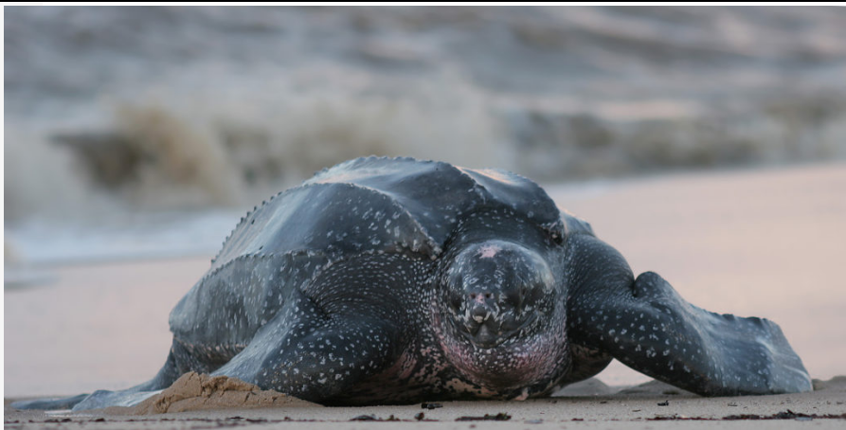

Slide 54
Elephant Seal
Both species of elephant seal have a breath-hold time of more than 100 minutes. This makes their dives as remarkable for their length as they are for depth. Male elephant seals often dive for more than 60 minutes at a time, and the depth record for this species is an incredible 7,835 feet (2,388 m). Like the leatherback turtle and the emperor penguin, food is the incentive for the seals’ astonishing dives. They prey primarily on deep-dwelling species including skates, rays, squid and octopus. Elephant seals are a deep-diving success because their bodies hold an abnormally large volume of blood. This allows them to store additional oxygen. They also have increased levels of myoglobin, allowing them to store oxygen in their muscles, a larger percentage of oxygen-carrying red blood cells, and exceptionally thick blubber to protect them from the cold at depth.

Slide 55
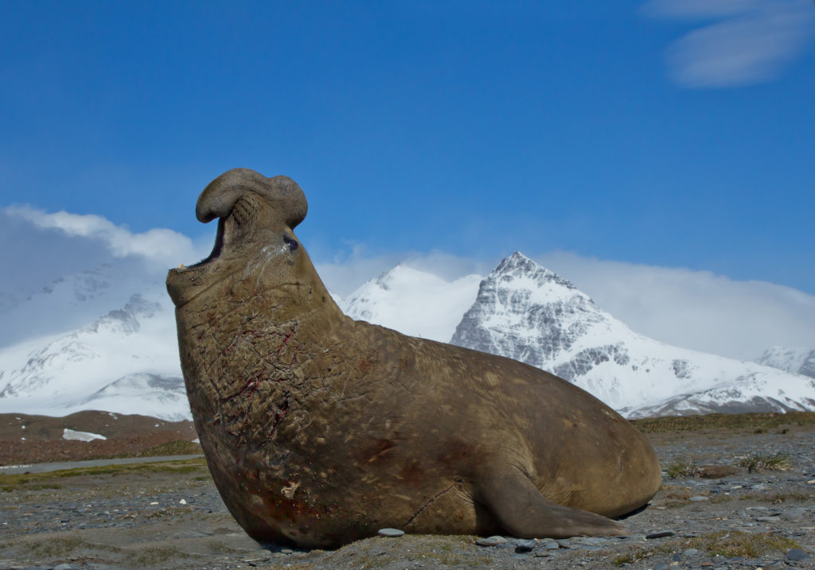

Slide 57
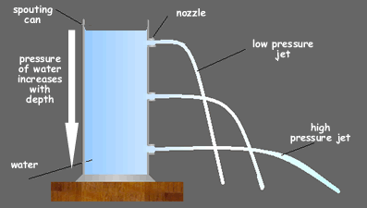
Do you see why the water from the lower hole goes farther?

Slide 58
Bernoulli’s Principle
As the Velocity (speed) of a fluid increases, the Pressure exerted by the fluid decreases
Remember air is a fluid. Fluids just flow, they do not have to be liquid.

Slide 59
This explains one of the forces that make an Airplane Fly
Airplanes have FOUR basic forces acting on them:
LIFT
LIFT
THRUST
THRUST
DRAG
DRAG
GRAVITY
GRAVITY
LIFT can be explained using Bernoulli’s Principle.

Slide 60
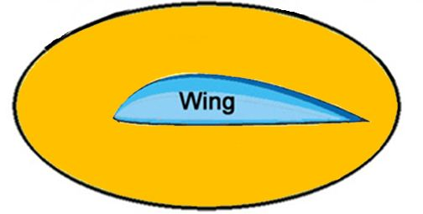
Cross section of an Airplane Wing
Lower Pressure
Air moves faster over the top and slower across the bottom. More pressure on the bottom makes lift. It pushes the wing up.
Higher Pressure

Slide 61
Venturi Effect
As the size of a fluid’s pathway decreases, the velocity of the fluid increases.

Slide 62
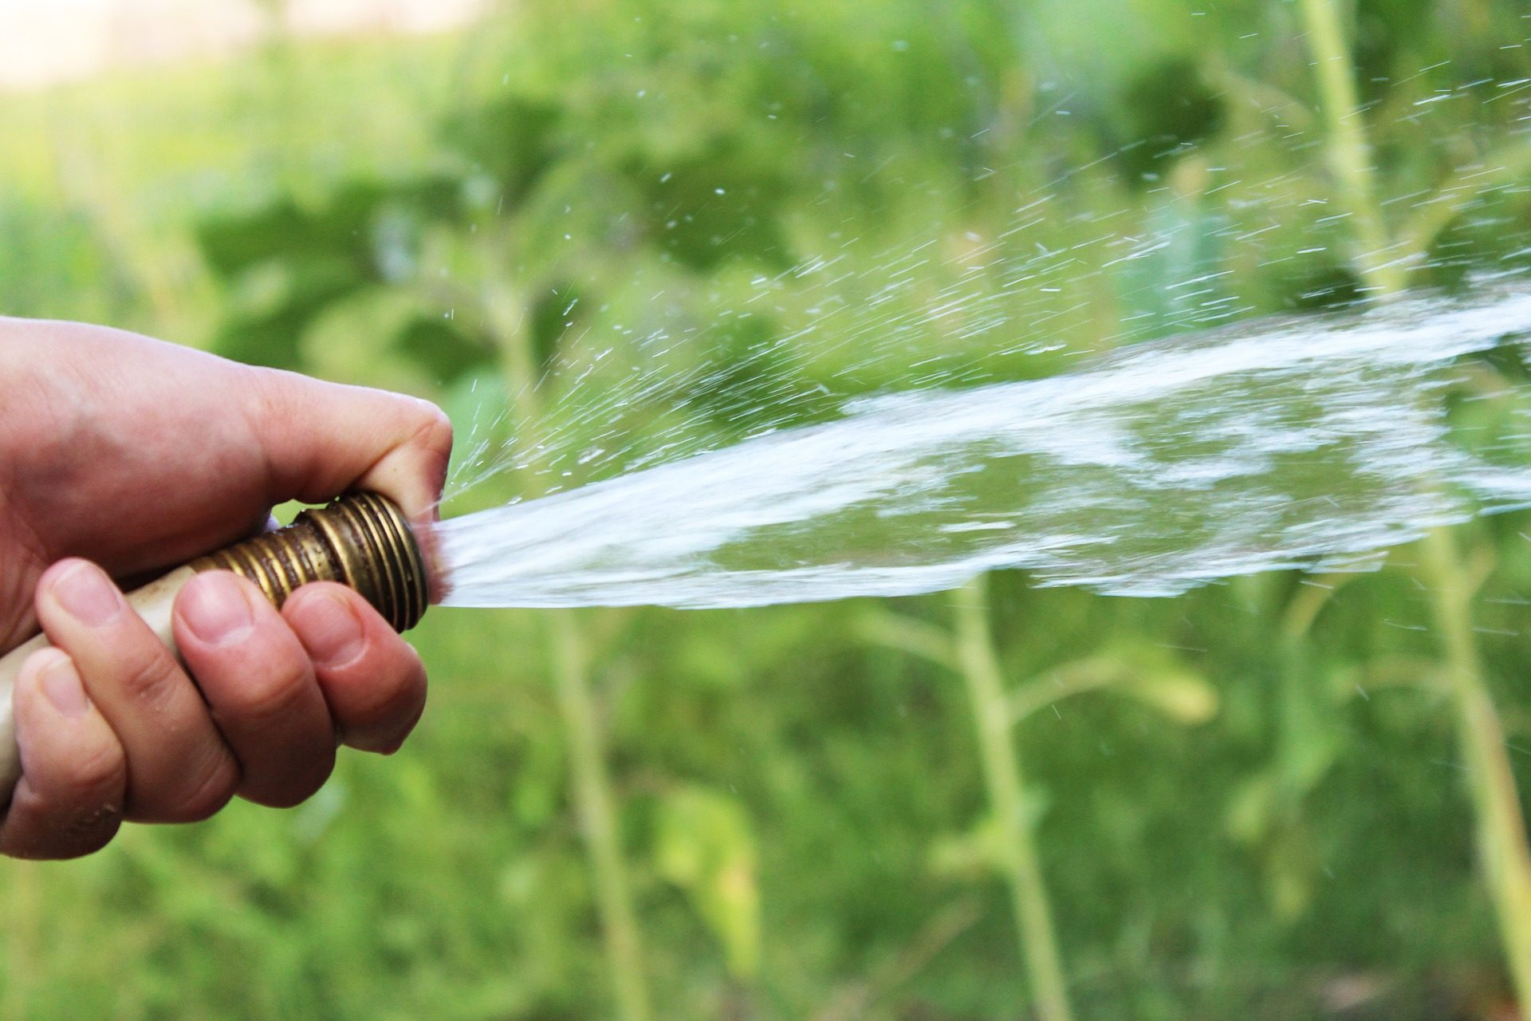
You use your knowledge of the Venturi effect to make the velocity of the spray greater by making the hose opening smaller with your thumb.

Slide 63
Archimedes’ Principle
The buoyant force on an object in a fluid is equal to the weight of the fluid displaced by the object

Slide 64
A simplified version of Archimedes principle states that an object will float in a fluid if the object is less dense than the fluid.
You saw this in the density lab that you did online.
Try this at home if you have the supplies. Put a grape in a cup of water. Add salt and stir until the grape floats. You have made the water denser.
Or put a raisin in a light colored carbonated drink. The bubbles will cling to the raisin and it will become buoyant.

Slide 65
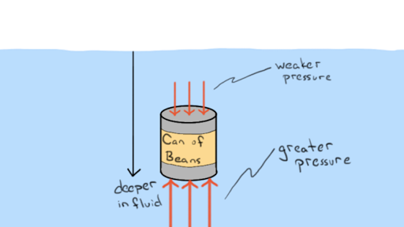
The water pushes up on an object that is in the water because there is more pressure on the lower part of the object and less pressure on the upper part. This causes an upward force on the object that is called the buoyant force. Even if the object isn’t floating, the fluid pushes up on it. You know you feel lighter in water even if you aren’t floating. This is because of this force.

Slide 67
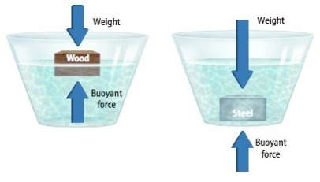
If the object is very dense, the buoyant force will not be enough for it to float.

Slide 68
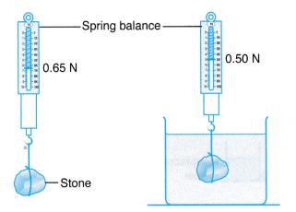
The buoyant force makes the rock seem lighter. The buoyant force is
.65N minus .50N

Slide 69
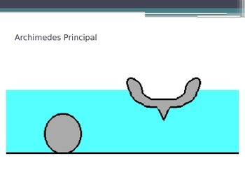
The boat can float because the air inside reduces its density.

Slide 70
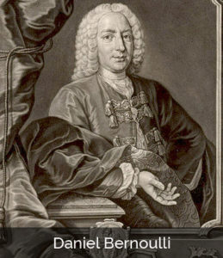
Bernoulli’s Principle
1700-1782

Slide 71
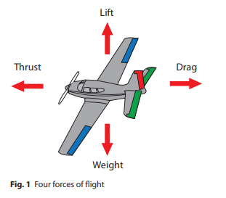

Slide 72
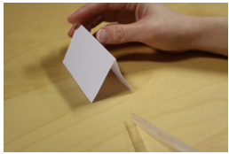
Try at least two of the following labs. If you do not have any of the objects needed to do the lab, search for the answers online. Either way, report your findings.

Slide 73
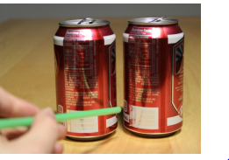
CAN-CAN
What happens when you blow between empty cans?

Slide 74
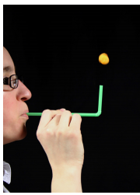
Try this:
Balancing Cheese Balls or ping pong balls.

Slide 76
Part D: Bernoulli's Water Gun
Give the students one cup filled with water and two straws.
Have students place one of the straws in the water.
Then, have students cut the second straw in half to use as a "blower."
Ask the students to predict what will happen if they blow across the top of one straw in the water with the other straw.
Have students blow across the top
of the straw with the other straw.
This is how spray bottles work.

Slide 77
Part C: Magic Moving Ball
Place two plastic cups about 6 inches apart.
Place a ping pong ball in one of the cups.
Ask the students to predict how to get the ball from one cup to the other without touching either the ball or cup.
Have the students try a few of their ideas.
Tell the students to gently blow across the top of the cup with the ball in it.

Slide 78
Fluids Quiz
You are standing on the ground. Describe two ways that you could increase the pressure between your feet and the ground.
As air blows into a narrow place between two buildings, does it speed up or slow down? Explain.
How does the pressure change as someone goes deeper in the sea?
Is there more pressure 25 feet deep under fresh water or 25 feet under salt water? Explain.
Why does a hot air balloon float?
What is the density of a 2 cm cubed block that has a mass of 8 grams?
What is the pressure of 100 Newtons pressing on an area of 5 meters squared?
How can a metal boat float? Isn’t metal too dense to float?
What does it mean to say that density is a intensive property?
10. Explain how the Bernoulli effect produce lift for an airplane wing.

