Slide 1
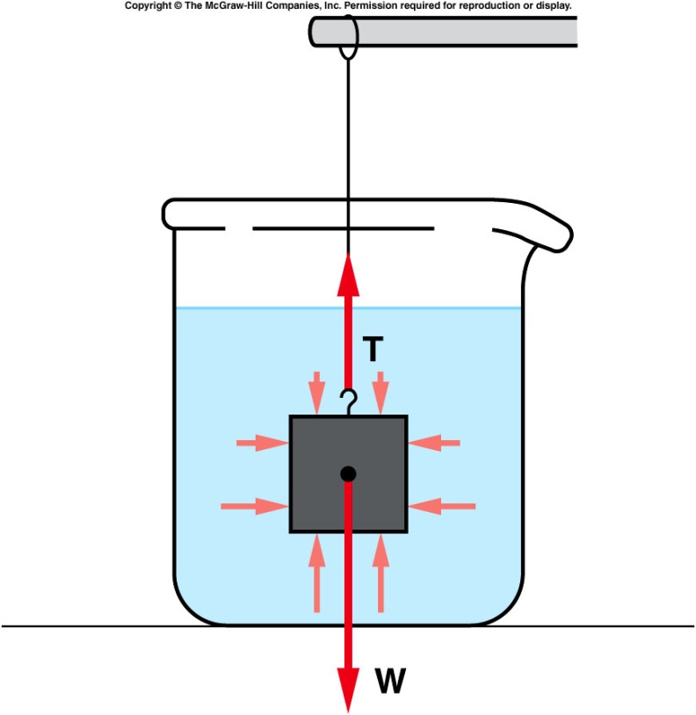
buoyant force
consider a block submerged in water, suspended from a string.
The pressure of the water pushes on the block from all sides.
Because the pressure increases with depth, the pressure at the bottom of the block is greater than at the top.
There is a larger force (F = PA) pushing up at the bottom than there is pushing down at the top.
The difference between these two forces is the buoyant force.
F = mg = density*volume*g
→pressure = F/A = density*g*volume/A
volume/A =height
→pressure = density*g*height
Pascal’s principle says: density*g*height
is the same everywhere at the same height and in all directions.
Notes:
Think of 3 people standing on top of each other. The person at the bottom feels the pressure of two people. The person at the middle feels the pressure of one person

Slide 2
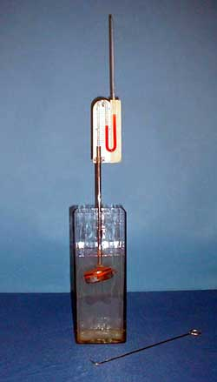
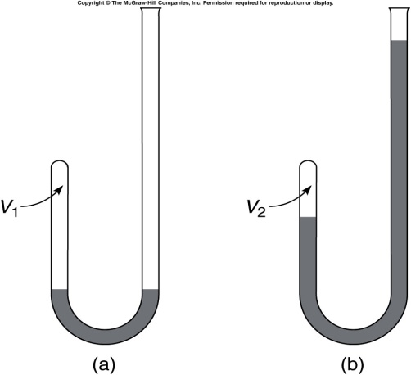
2B-04 Liquid Pressure
Investigating Pressure in different directions within a liquid in equilibrium.
What will happen to the reading on the manometer as the sensor is rotated ?
The increase in pressure ρgh is measured by the difference in height of the liquid in the U tube.
g
h
A
B
A
B
AT ANY GIVEN POINT IN A STATIONARY LIQUID, THE PRESSURE IS THE SAME IN ALL DIRECTIONS.
Notes:
A pillbox shaped sensor has a rubber diaphragm and is attached to a liquid manometer. The sensor is lowered into a deep vessel to a certain depth. The pressure at that depth is indicated on the manometer. The reading on the manometer does not change as the sensor is rotated. The tube holding the sensor is held in place by a clamp that allows the tube to slide downward into the water. DO THIS VERY SLOWLY or you will find yourself drenched with red liquid from the manometer!!!. Once the sensor is at the desired depth, use the wire hook to rotate the sensor.

Slide 3
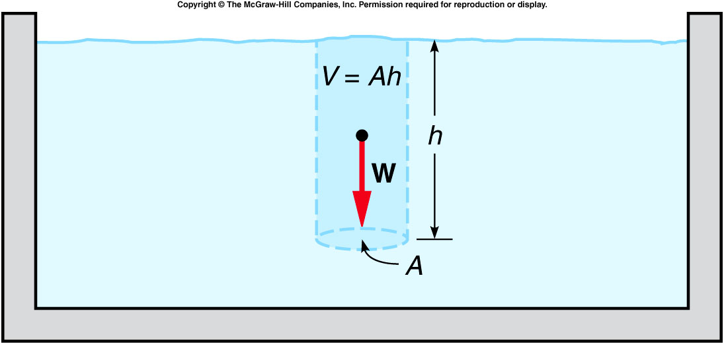
Archimedes’ Principle
Archimedes’ Principle: The buoyant force acting on an object fully or partially submerged in a fluid is equal to the weight of the fluid displaced by the object.
pressure = density*g*height →
buoyant force = difference between forces on top and bottom surface
= (area*density*h)*g = mg
= weight of the fluid displaced by the object.

Slide 4
2B-05 Pressure Forces in Liquids
What happens as the submerged cylinder filled with air is filled with water ?
An open ended cylinder kept shut by liquid pressure
There are two forces acting on the plate. It’s weight down and PA up. When PA exceeds the weight the cylinder stays intact
Air
PA
In this situation the plate has to now support the weight of the water and when the weight of the water plus plate exceeds PA the cylinder opens
Water
PA
Notes:
An aluminum disk is held tightly by a string against the bottom of an open cylinder. The cylinder is then slowly lowered into a large beaker of water and held in place. The string is released and the disk stays in place because of the pressure forces exerted upward from the water. Water containing red food coloring is slowly poured into the cylinder. When the red liquid reaches the height of the water in the beaker, the pressure is the same on both sides of the disk which then drops away from the cylinder.

Slide 5
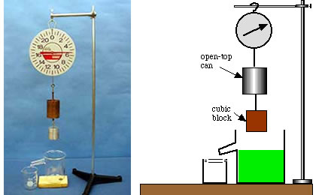
2B-10 Archimedes II
Take the 1st reading before put the object into large beaker where the water level is just at the overflow point.
One then submerge the object into the water while the displaced water is caught in a small beaker. Take the 2nd reading on the scale.
One then put the overflowed water to the copper container, take the 3rd reading. The 3rd reading of the scale will
Be the same as the 2nd reading.
Be the same as the 1st reading
Be smaller than the 1st reading.
Notes:
Preparation: Fill the overflow beaker until water begins to come out the spout. (Catch it in the small beaker.) After the water has stopped dripping, discard the water from the small beaker and place the beaker back under the spout. After recording the scale reading, VERY SLOWLY lower the block into the water until it is just submerged. Wait a bit until the water has finished dripping from the spout. Record the new scale reading. Then take the beaker and pour the caught water into the open-top can.

Slide 6
2B-10 Archimedes II
Use a scale to establish the relationship between the Buoyant Force on an object and the Weight of Fluid Displaced by the object
T₁
T₂
T₃
F_{B}
F_{B}
A
B
C
Mg
W_{DF}
Mg
Mg
A. The block is not immersed T₁ = Mg
B. The block is immersed but the liquid runs out T₂ = Mg – F_{B}
C. The displaced liquid is poured into the can T₃ = Mg – F_{B} + W_{DF}
T₁ is found to equal T₃ which means that the bouyant force FB is
equal to W_{DF} the Weight of the displaced Fluid
THE BUOYANT FORCE IS EQUAL TO THE WEIGHT OF THE FLUID DISPLACED.
Notes:
level is just at the overflow point. The displaced water is caught in a small beaker

Slide 7
Quiz: Boat displaces 2.5 m³ of water. Density of water ρ_{H2O} = 1000 kg/m³. What is the mass of water displaced? What is the buoyant force?
A). Mass = 2500 kg, buoyant force = 24500N
B). Mass = 250 kg, buoyant force = 2450N
C). Mass = 25 kg, buoyant force = 245N
D). Mass = 2500 kg, buoyant force = 2450N
E). Mass = 2500 kg, buoyant force = 245N
Mass of fluid displaced
(m_{FD}) = volume x density of fluid.
M_{FD} = V_{FD}ρ_{H2O} = (2.5 m³)(1000 kg/m³) = 2500 kg
F_{b} = W_{FD}
Buoyant force equals weight of fluid displaced.
F_{b} = W_{FD} = m_{FD} g = (2500 kg)(9.8 m/s²) = 24500 N

Slide 8
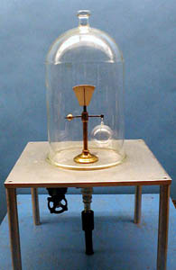
2A-08 Buoyancy of Air
Investigating the Buoyant force resulting from Air
After air being pumped out
m_{b} will move downward
m_{a} will move downward
Apparatus remain balanced
ρ_{air}gV_{b}
ρ_{air}gV_{a}
m_{a}g
m_{b}g
Setting the sum of torques on equal-arm balance about pivot equal to zero, we have in the presence of air:
m_{a}g – ρ_{air}gV_{a} = ρ_{air}gV_{b} – m_{a}g
V_{b} > V_{a} implies m_{b} > m_{a} which is demonstrated in vacuum
IF SENSITIVE WEIGHING OF AN OBJECT IS REQUIRED, UNEQUAL BUOYANT FORCES COULD AFFECT THE RESULTS.
Notes:
A small balance supports a glass bulb on one arm and a balancing weight of much smaller volume on the other. A bell jar is placed over the apparatus and evacuated. The glass sphere now appears heavier, due to its greater loss of buoyancy.

