Slide 1
Energy from the Sun Workshop
Introduction to Energy

Slide 2
A NEED Energy Unit
8 Steps
Science of Energy
Sources of Energy
Electricity
Transportation
Efficiency and Conservation
Enrichment and Reinforcement
Evaluation
Recognition
Easily Adaptable
Statistics updated annually
Curriculum units updated on rotating, periodic basis

Slide 3
What is Energy?
“The ability to do work”
Causes changes
Two forms
Potential
Kinetic

Slide 4
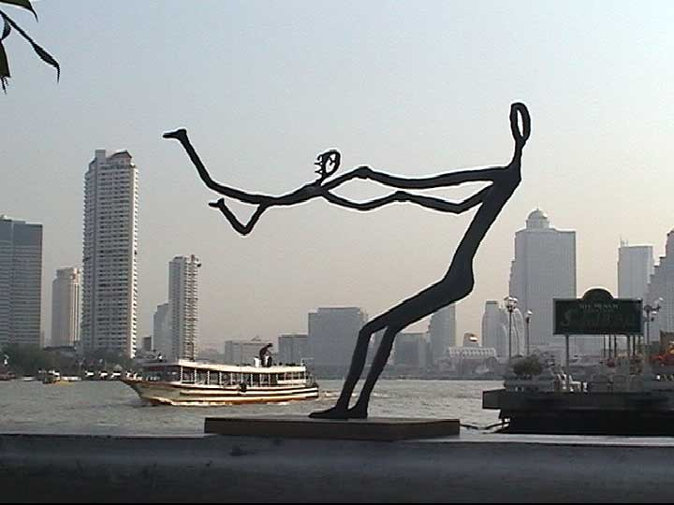
Potential Energy
Gravitational Energy The energy an object or substance has because of its position; anything “up high”

Slide 5
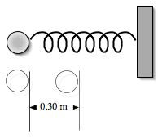
Potential Energy
Stored Mechanical Energy
Energy stored in an object by the application of force
Must push or pull on an object

Slide 6
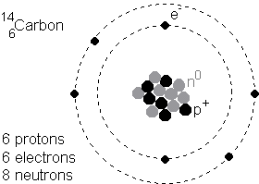
Potential Energy
Nuclear Energy
Energy stored in the nucleus of the atom
Holds the nucleus together

Slide 7
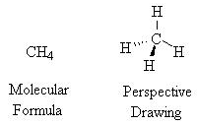
Potential Energy
Chemical Energy Energy stored in the bonds between atoms
Holds molecules together

Slide 8
Kinetic Energy
Mechanical Energy (Motion)
Movement of objects or substances from one place to another
Notes:
.

Slide 9
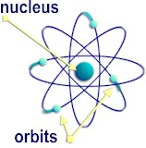
Kinetic Energy
Electrical Energy Movement of electrons in one direction
NOT AN ELECTRON PARADE!

Slide 10
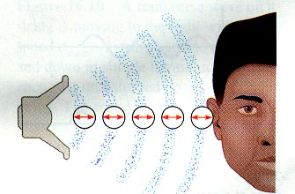
Kinetic Energy
Sound Energy Movement of energy through substances in the form of longitudinal
(compression) waves

Slide 11
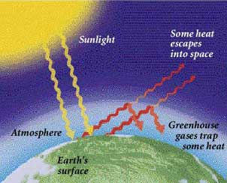
Kinetic Energy
Radiant Energy Electromagnetic energy that travels in transverse waves

Slide 12
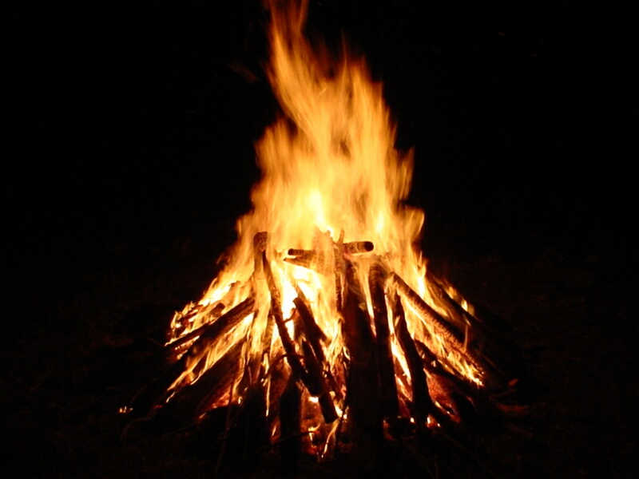
Kinetic Energy
Thermal Energy (a.k.a. Heat)
Internal energy of a substance due to the vibration of atoms and molecules making up the substance

Slide 13
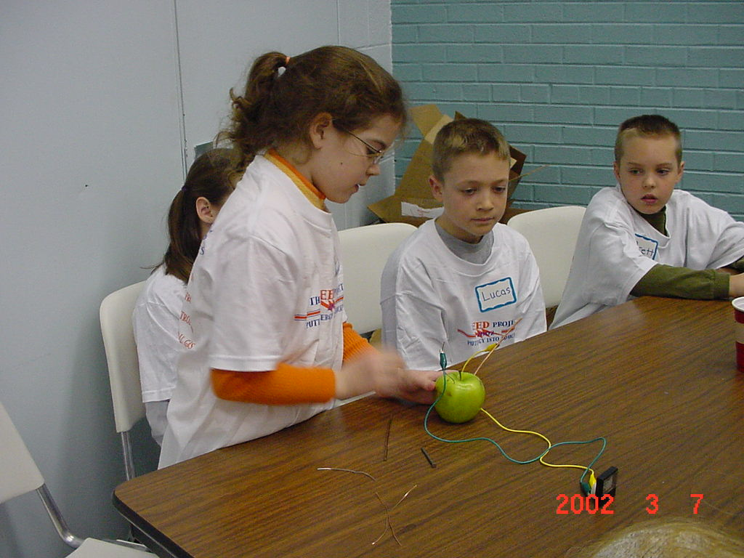
Science of Energy

Slide 14
Why study the Science of Energy?
Develop understanding of the science behind energy usage
NEED kit allows hands-on learning
Kids teaching kids. First they learn their own station and then teach it to their classmates (Jigsaw).

Slide 15
How Does Science of Energy Work?
Teacher demonstration
Six student lab stations
Step-by-step teacher guides with background information.
Emphasis is placed on observations, measurements and comparisons.

Slide 16
Objectives
Explain what energy enables us to do.
Differentiate between forms and sources of energy.
Demonstrate how energy is stored in the major energy sources.
Describe the main forms of energy and give examples.
Explain energy transformations.
Trace the flow of an energy system.

Slide 17
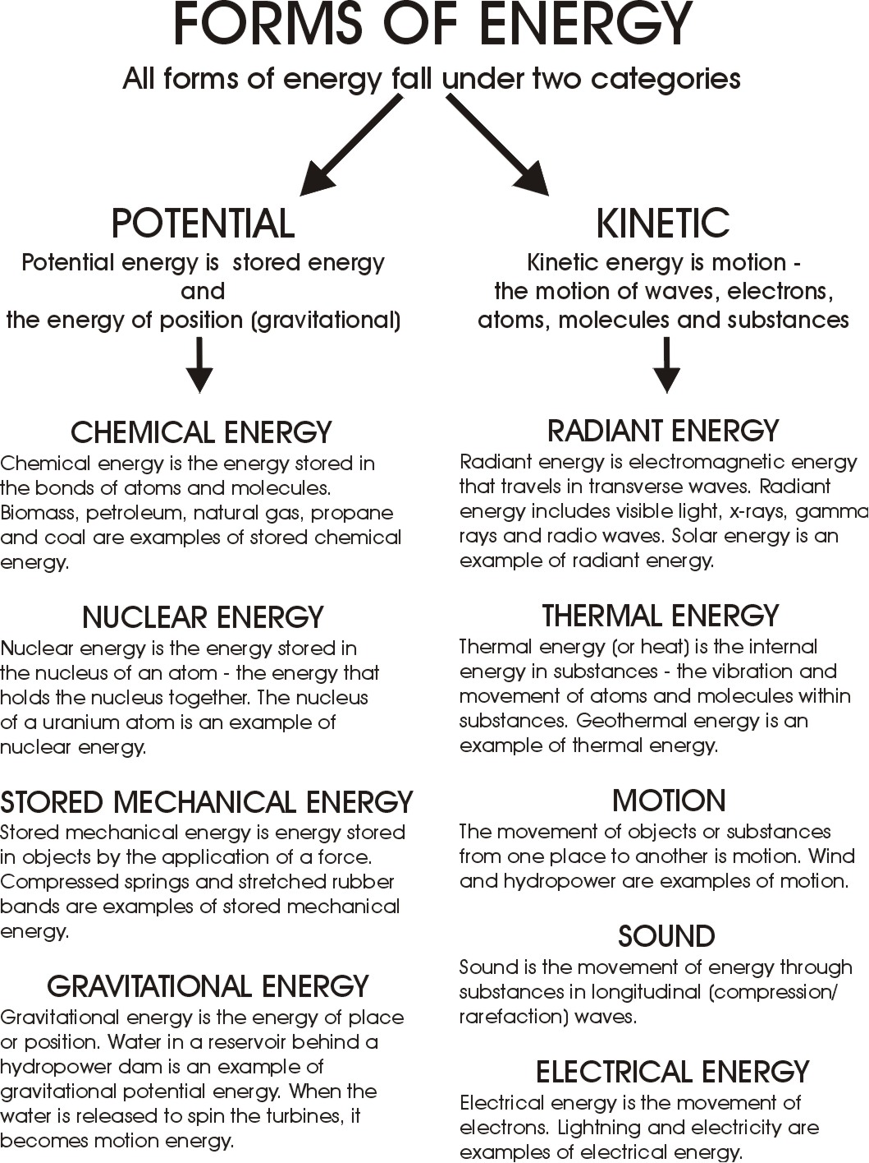

Slide 18
Energy Transfers
Energy can not be created nor destroyed, only changed.
Law of Conservation of Energy
First Law of Thermodynamics
Energy will always transfer from high to low.
No energy transfer is 100% efficient.

Slide 19
Before | XXºc | YYºc
After | XXXºc | YYYºc
Change | xºc | yºc

Slide 20
First Rotation
Second Rotation
Third Rotation
Fourth Rotation
Fifth Rotation
Sixth Rotation

Slide 21
Describe the Energy Transformations
Striking a match
Photovoltaic cell
Photosynthesis
Movement of the Gulf Stream
Interior temperature increase of a car

Slide 22
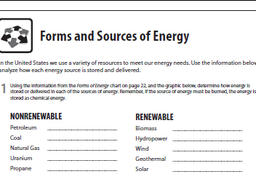
Transition: Forms to Sources
Forms - How Scientists Classify Energy
Sources - Where We Get the Energy To Make Our Lives More Comfortable, Convenient, & Productive
chemical
chemical
chemical
motion
chemical
motion
nuclear
thermal
chemical
radiant

Slide 23
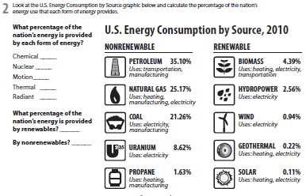
Transition: Forms to Sources
Forms - How Scientists Classify Energy
Sources - Where We Get the Energy To Make Our Lives More Comfortable, Convenient, & Productive
87.55%
8.62%
3.50%
0.22%
0.11%
8.22%
91.78%

Slide 24
For More Information
If you have questions, we have answers:
www.need.org – our website
info@need.org – questions about NEED
cturrel@need.org – questions about this workshop
1-800-875-5029 – NEED main office phone number

